Slide 1

Established. 1910

Slide 2
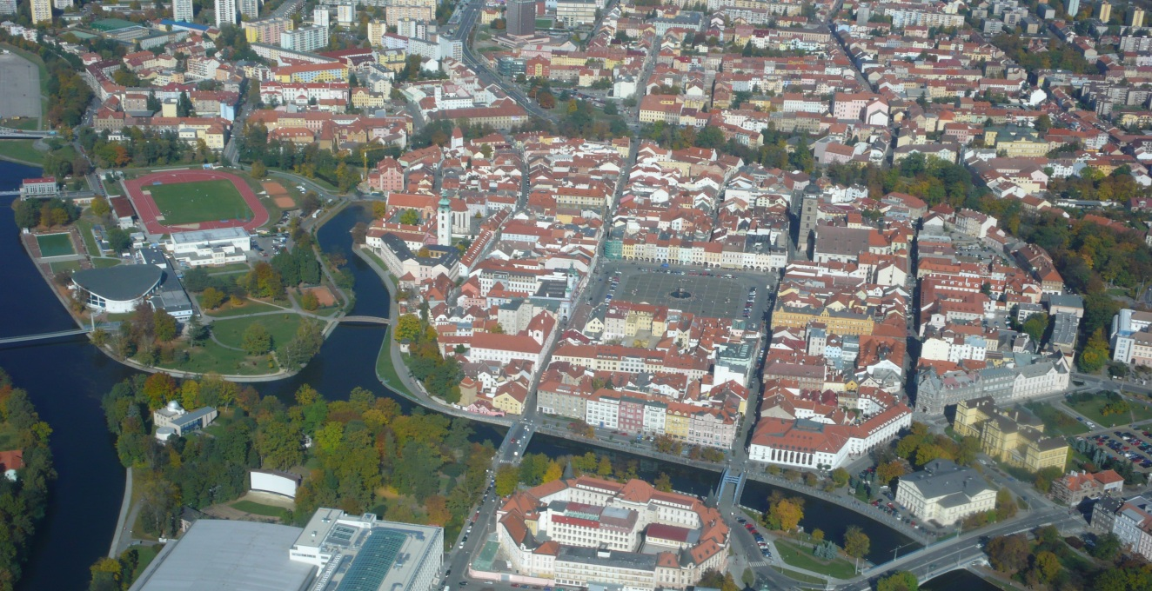

Slide 3
Upper Secondary
technical
School of Civil
Engineering

Slide 4
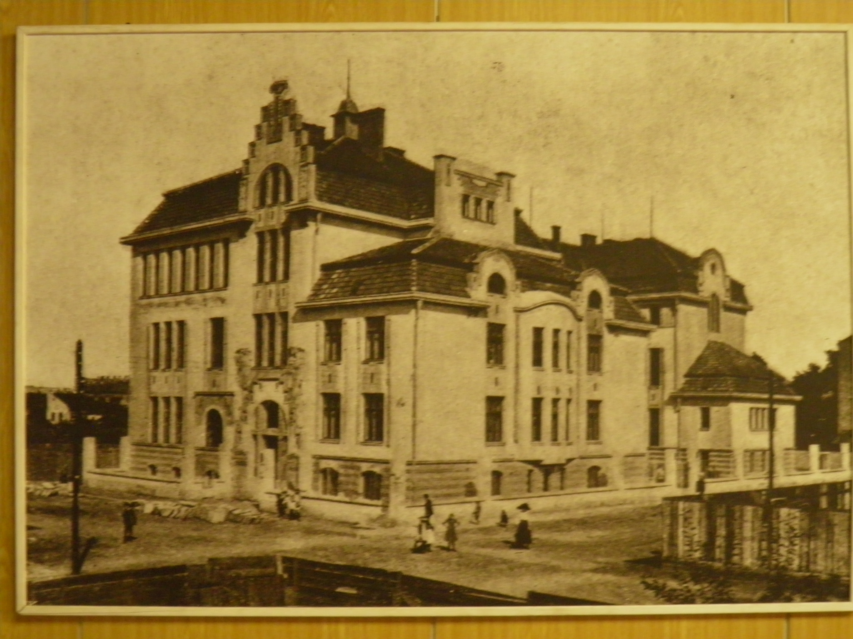
It was built in the Art Nouveau style

Slide 5
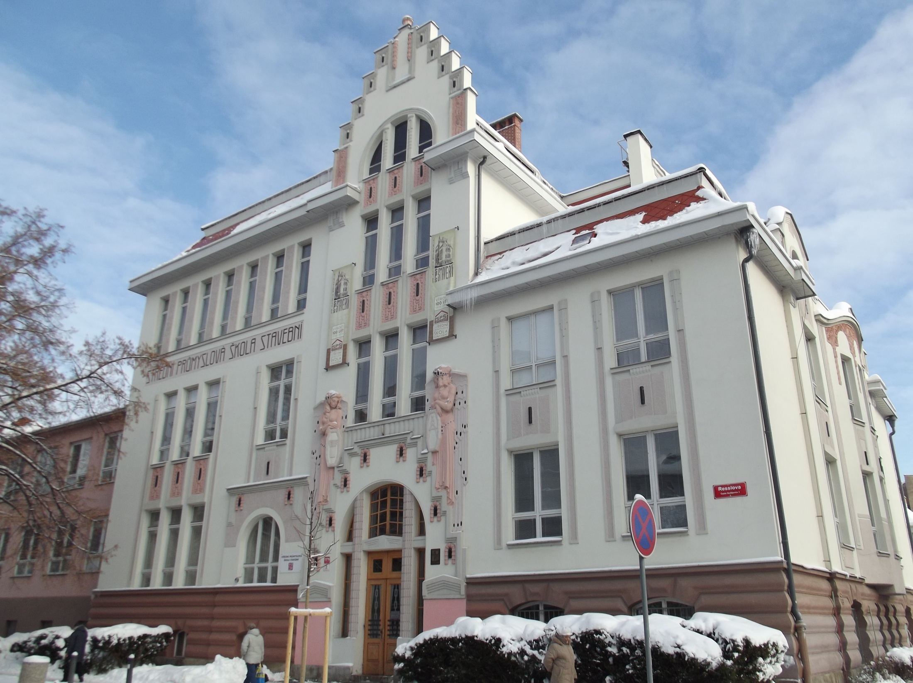

Slide 6
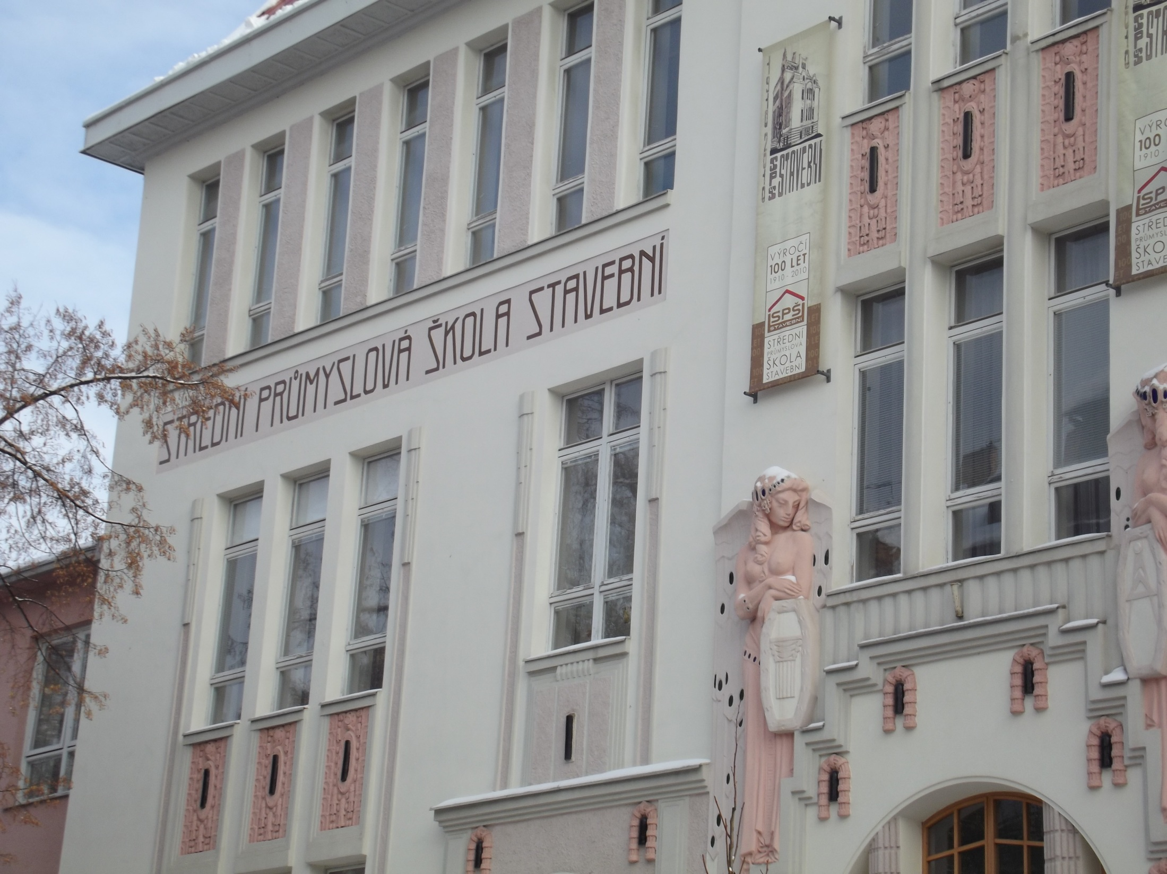

Slide 7
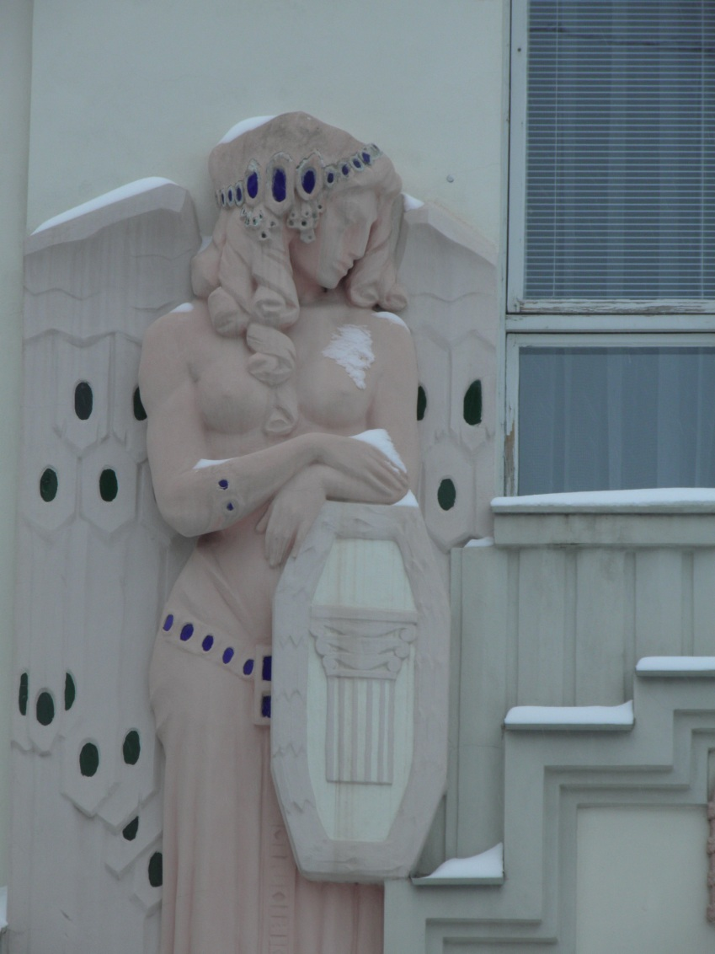
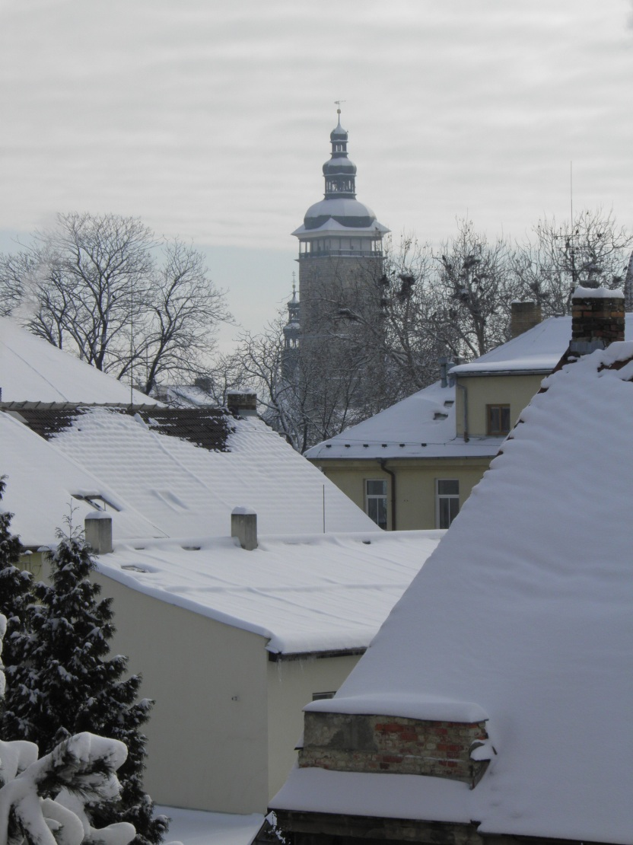

Slide 8
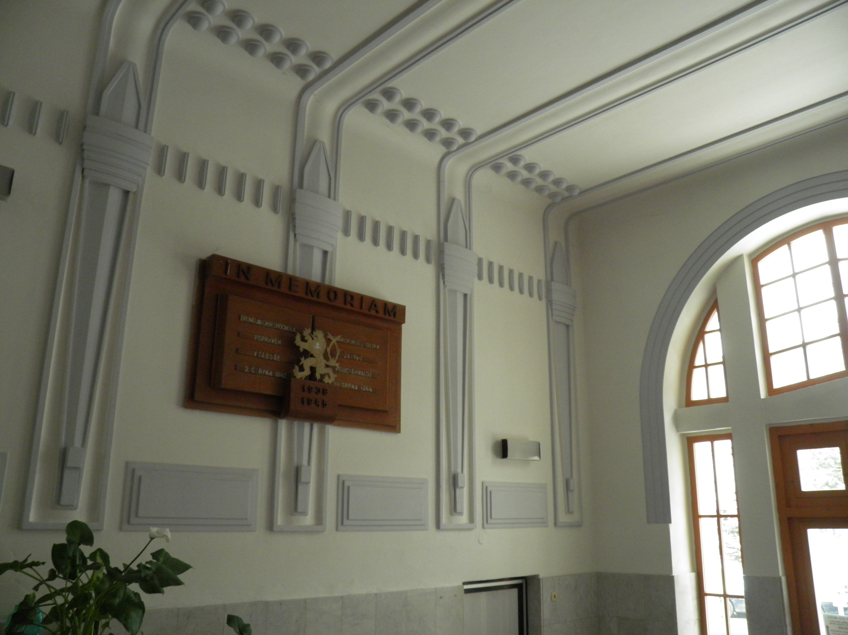

Slide 9
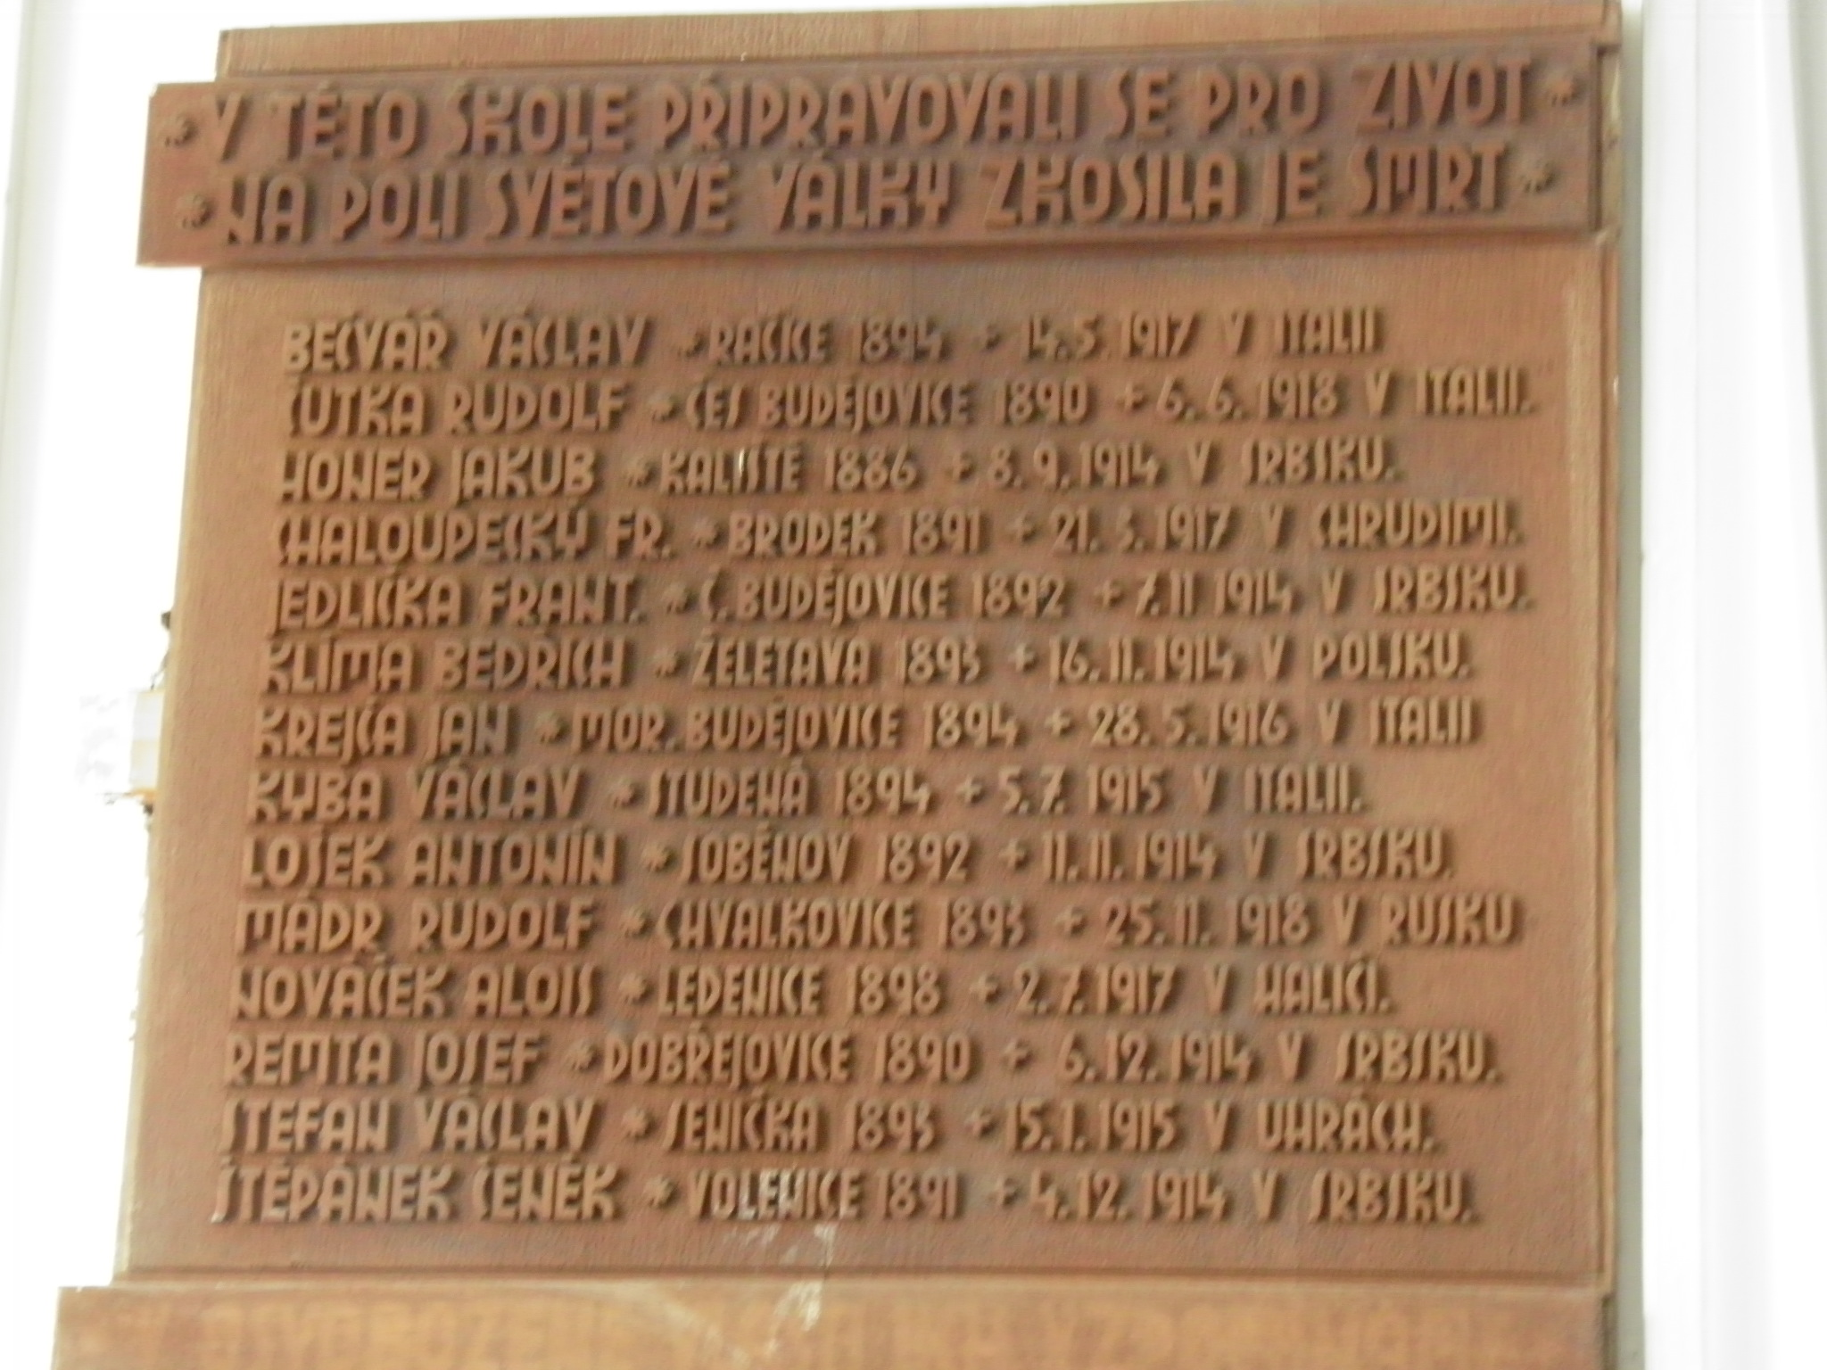

Slide 10
School in numbers
This year there are:
513 students
in 25 classes
47 teachers
46 subjects are taught here
in 2 fields of study:
Civil Engineering and Geodesy

Slide 11
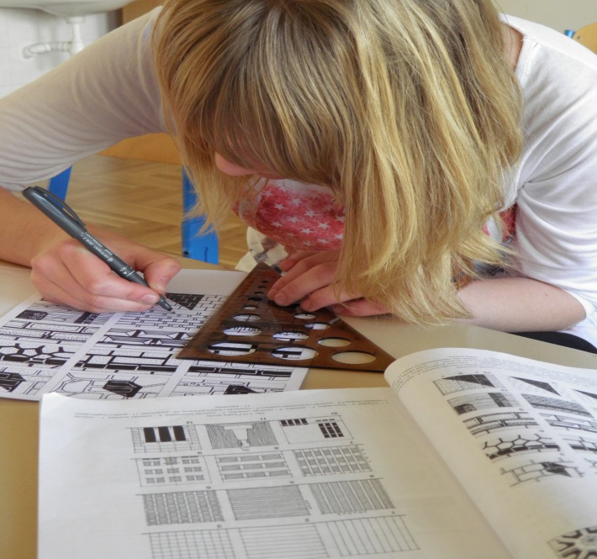
Some of the subjects are:
Structural Engineering
Construction Exercises
Technical Drawing and Sketching
Architecture

Slide 12
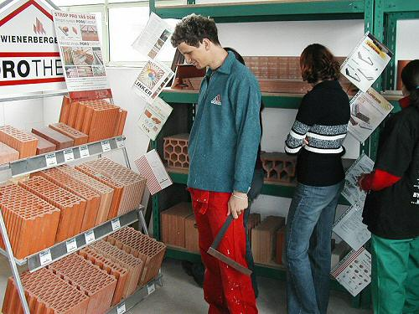
Materials Engineering
Structural Mechanics
Construction Machines
Building Structures
Topography and Mapping

Slide 13
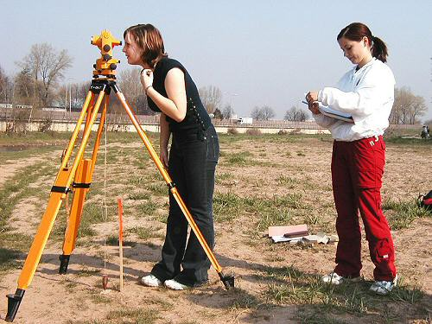
Economics
Management
Geodesy/Surveying
Geoinformatics
Computergraphics

Slide 14
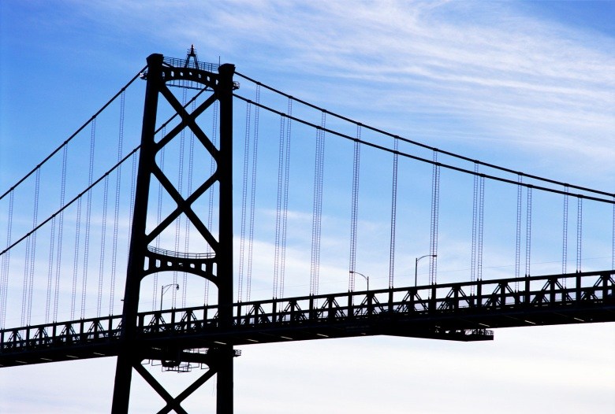
Engineering Structures
Transportation Engineering
Bridge Construction
Geology and Foundation Engineering
Water Structures
Hydrology and Hydraulics

Slide 15

Geography
Biology and Environment
Engineering Structures
Transportation Engineering
Bridge Construction

Slide 16
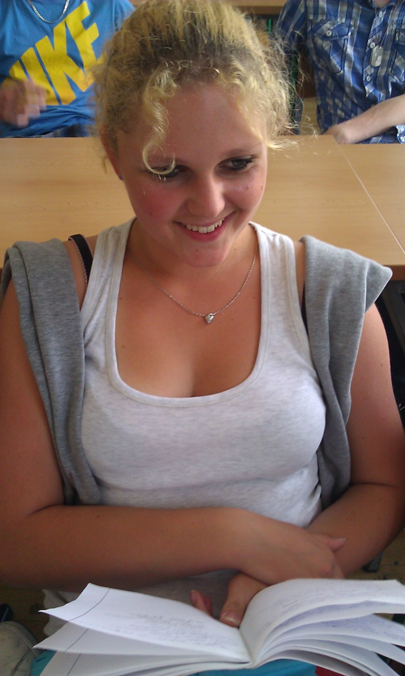
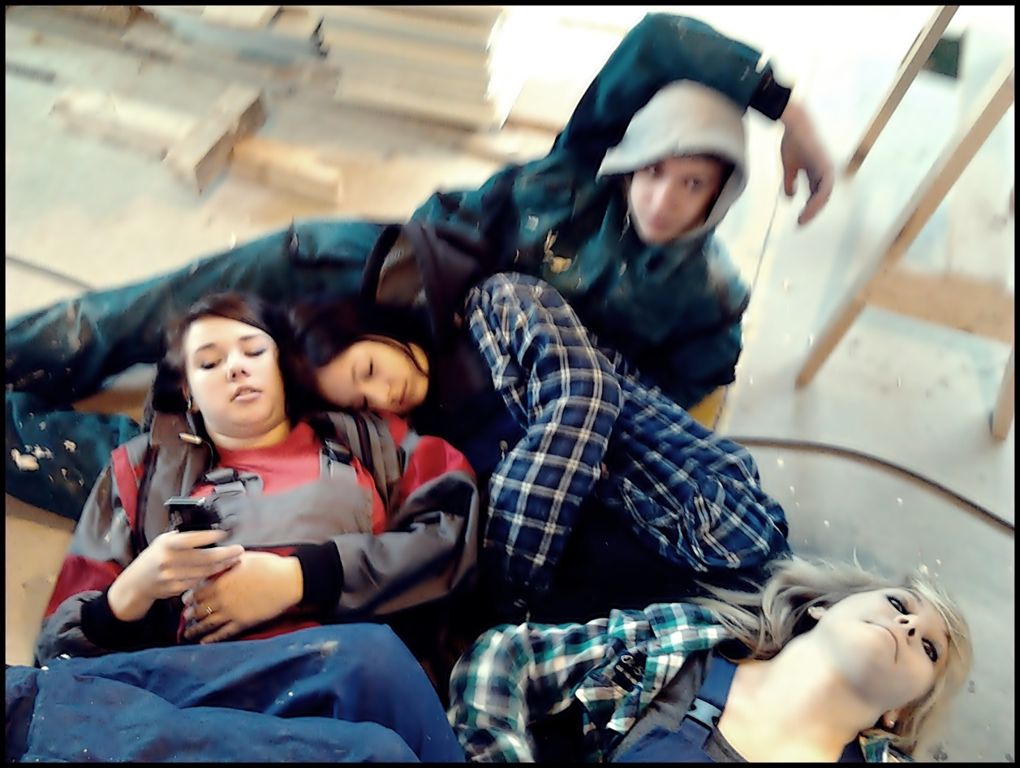
Our typical day

Slide 17
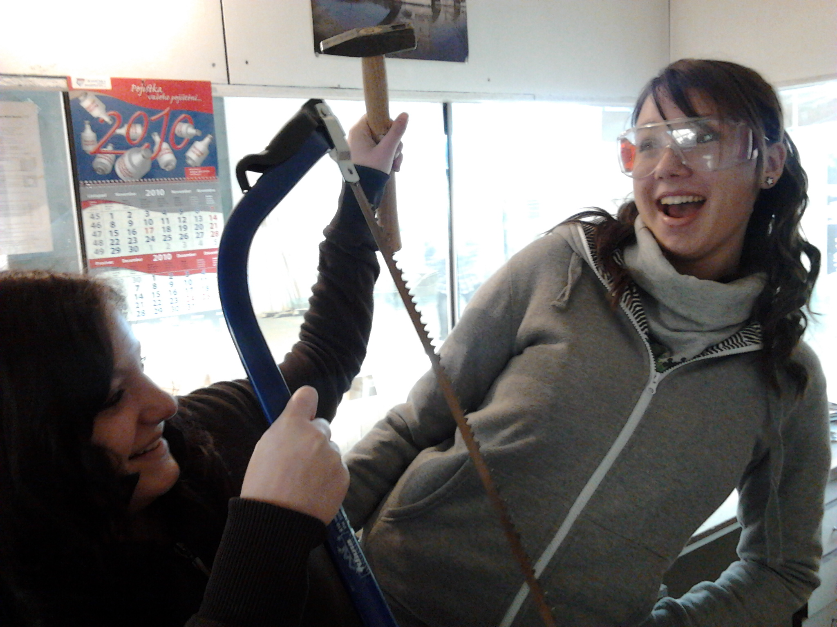

Slide 18
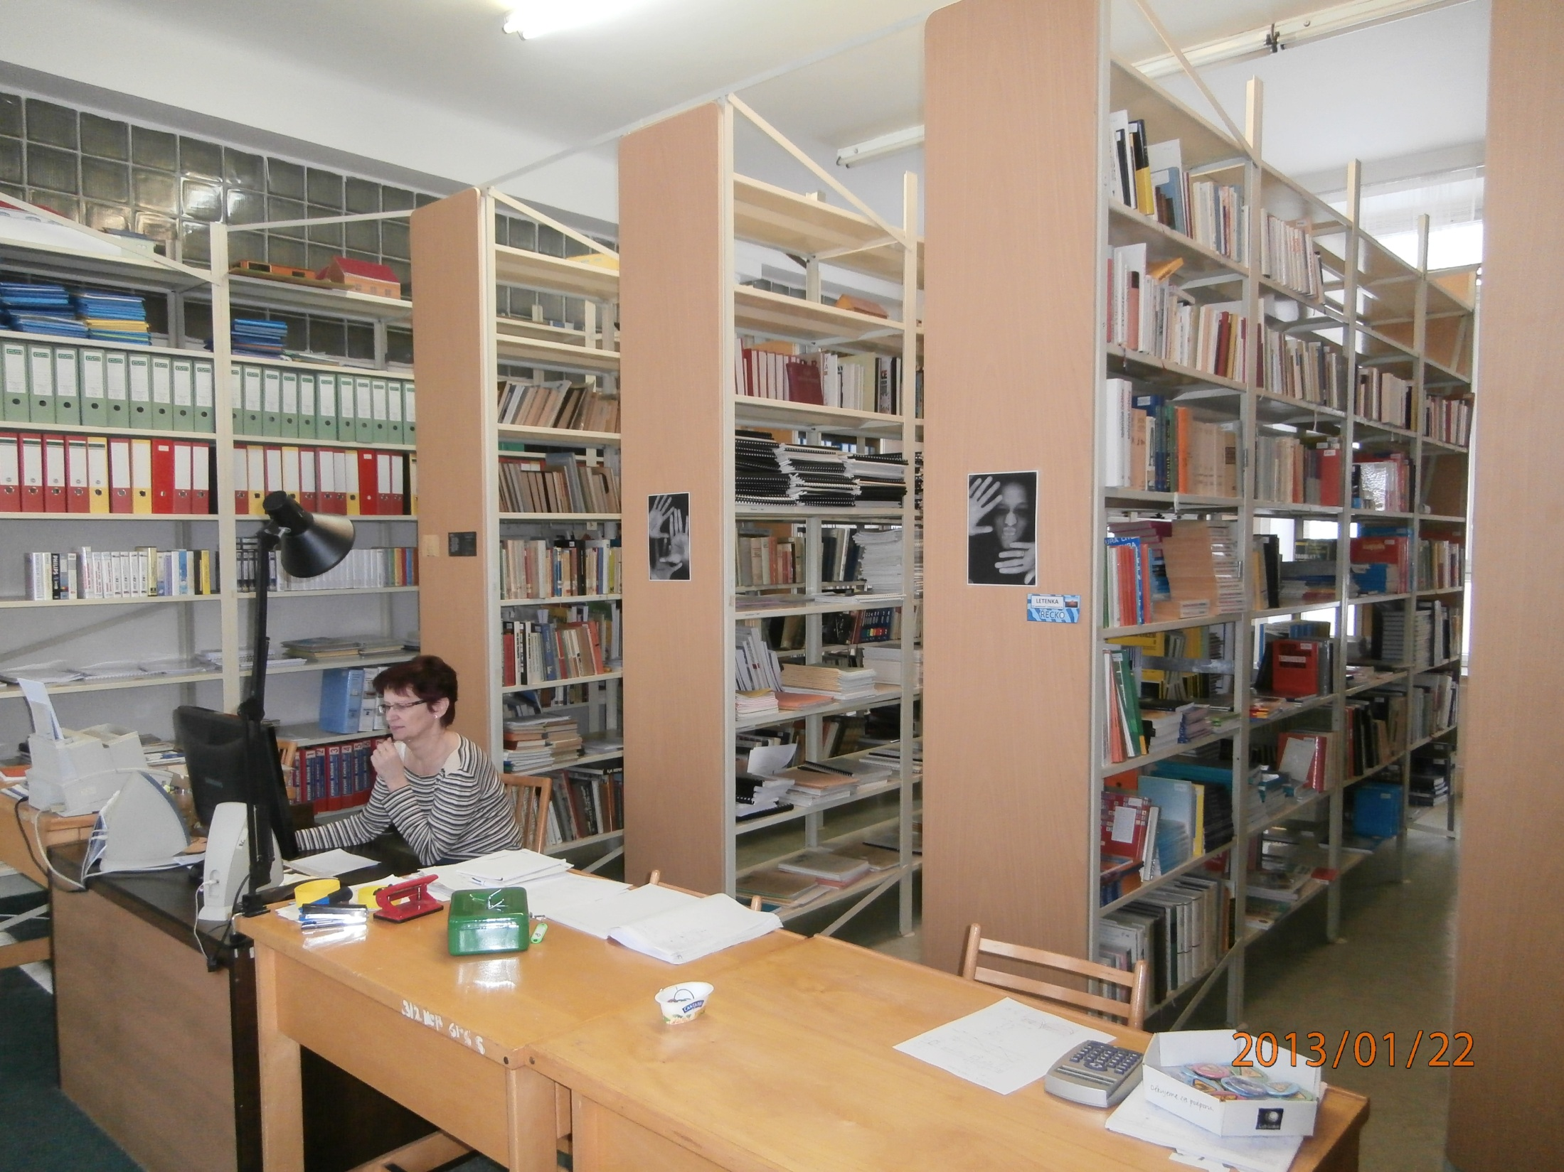

Slide 19
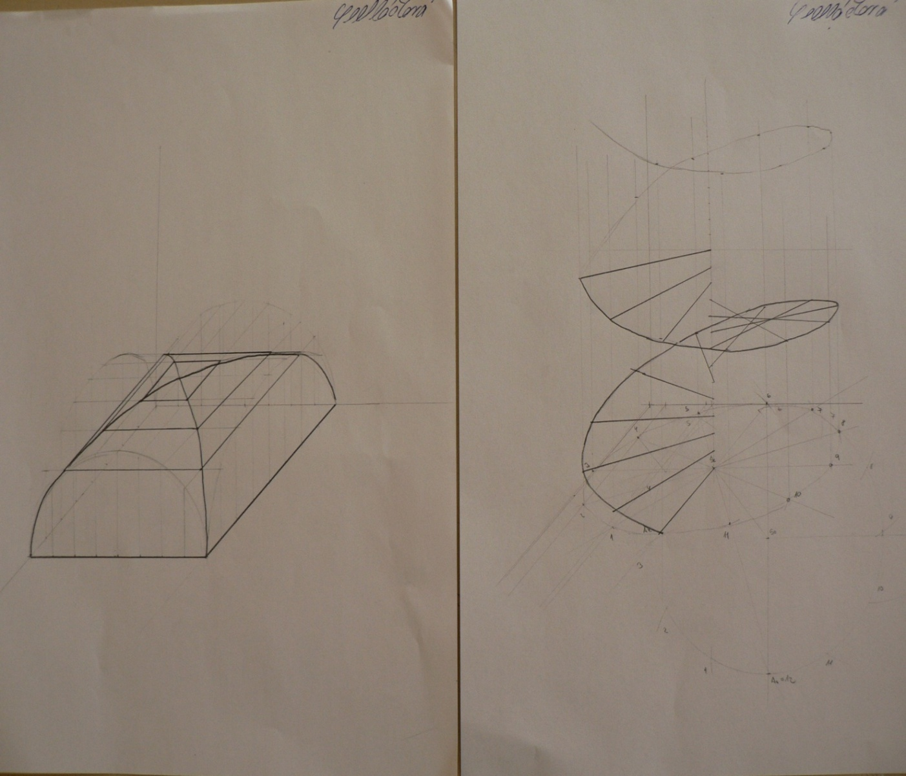
We do a lot of Descriptive Geometry ☹

Slide 20
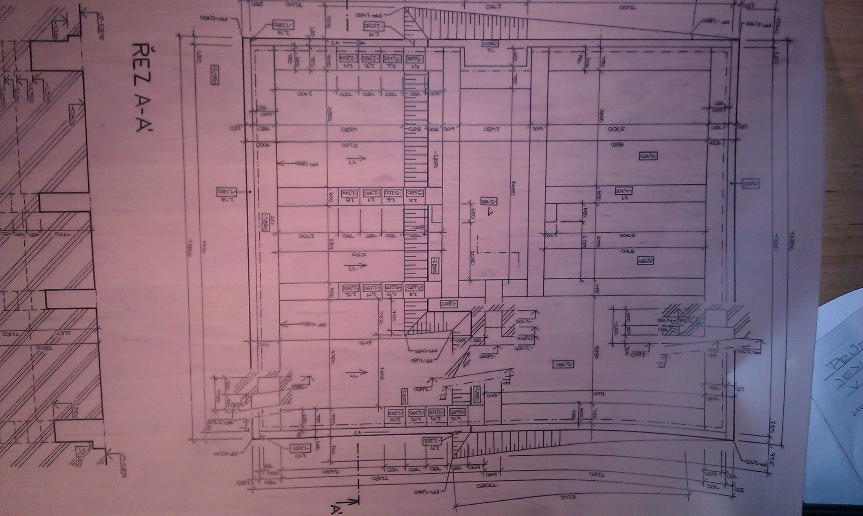
We must draw a lot of designs.
It takes a lot of time.
It's very difficult, but we have to practise it.

Slide 21
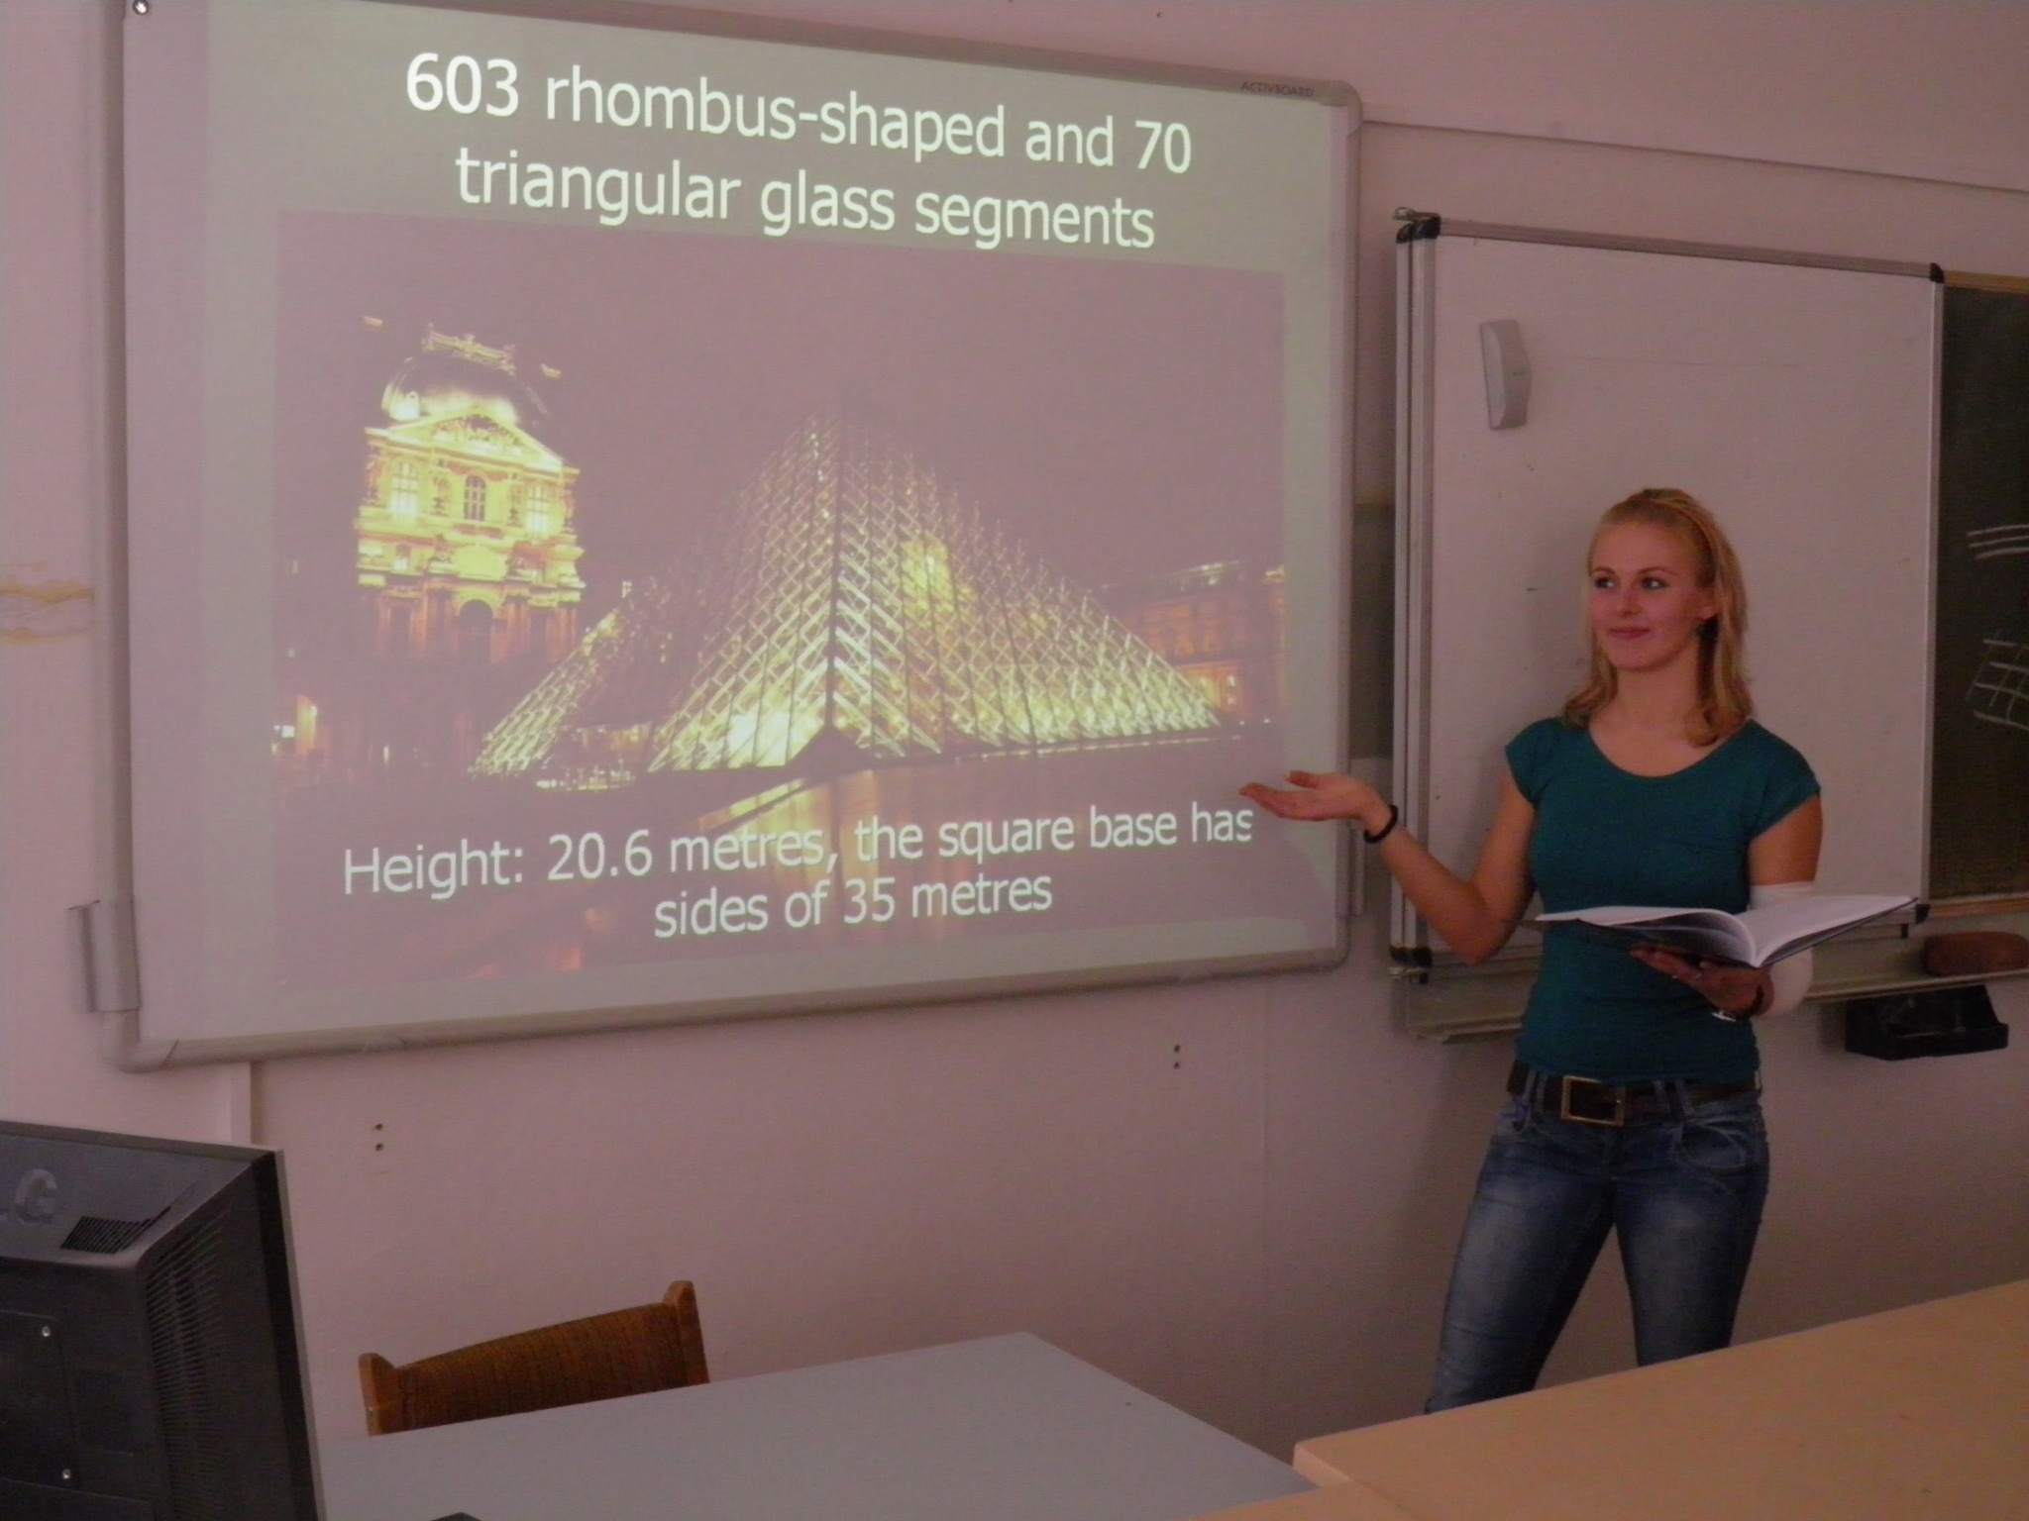

Slide 22
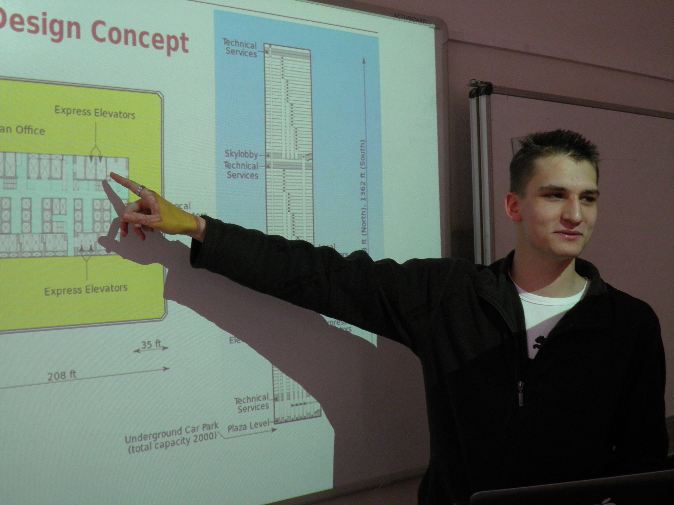

Slide 23
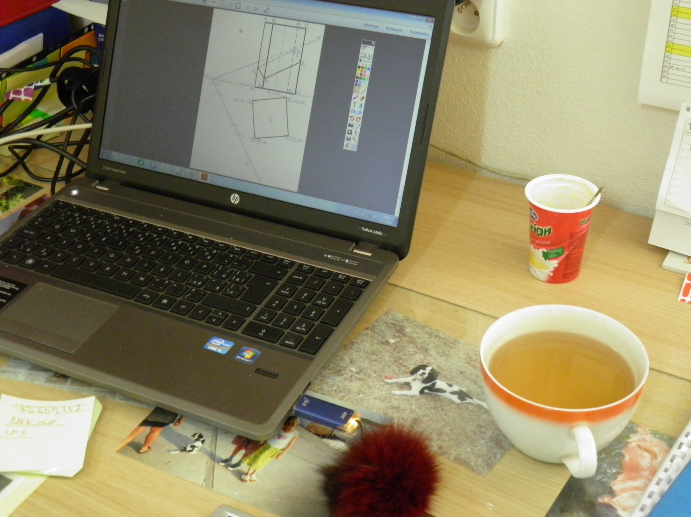

Slide 24
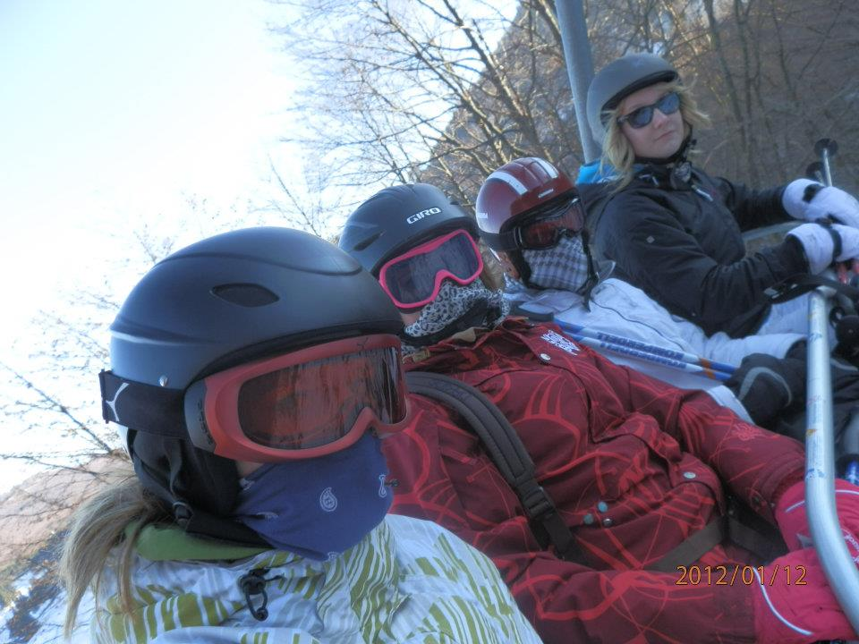

Slide 25
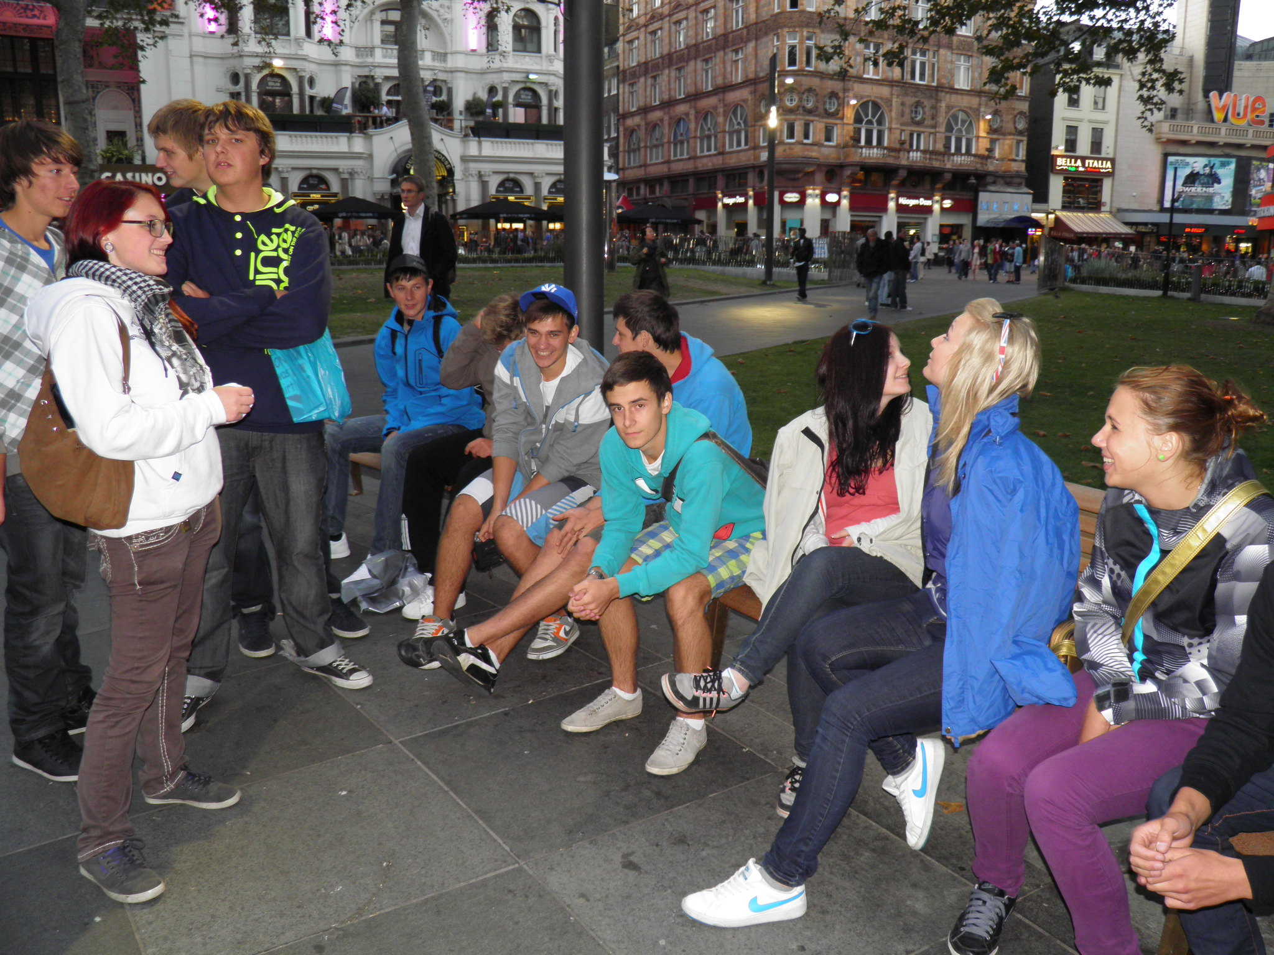
We went to London.

Slide 26
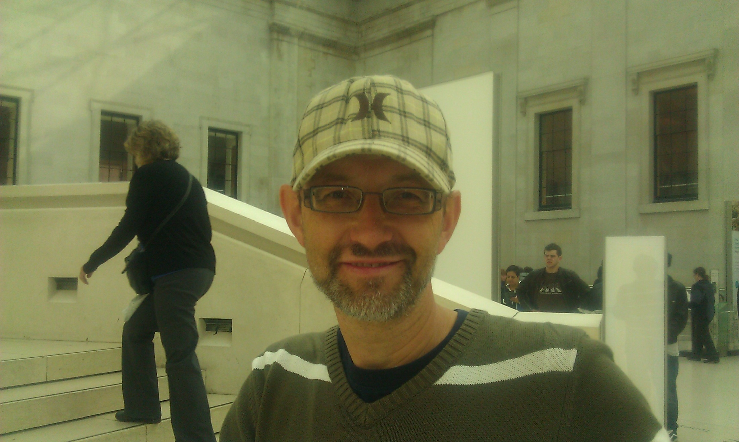
With our favorite teacher

Slide 27
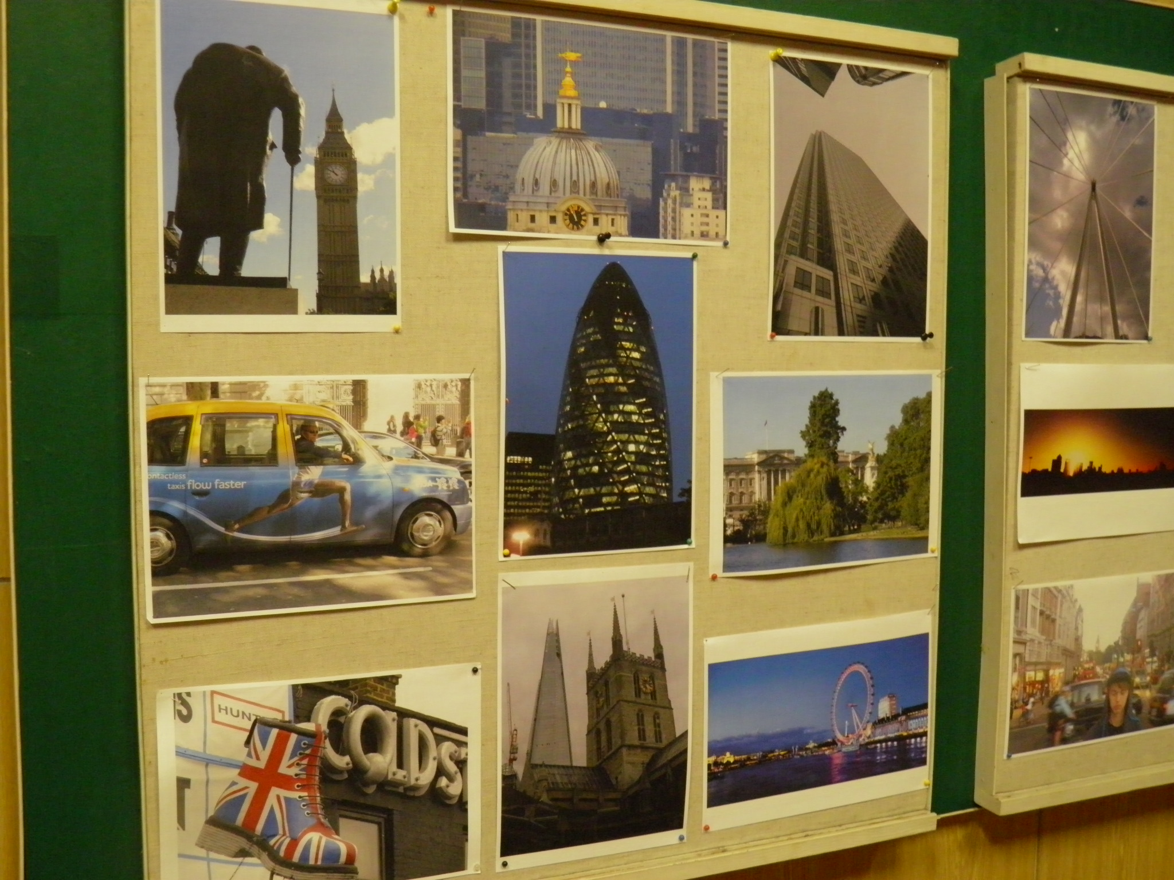

Slide 28
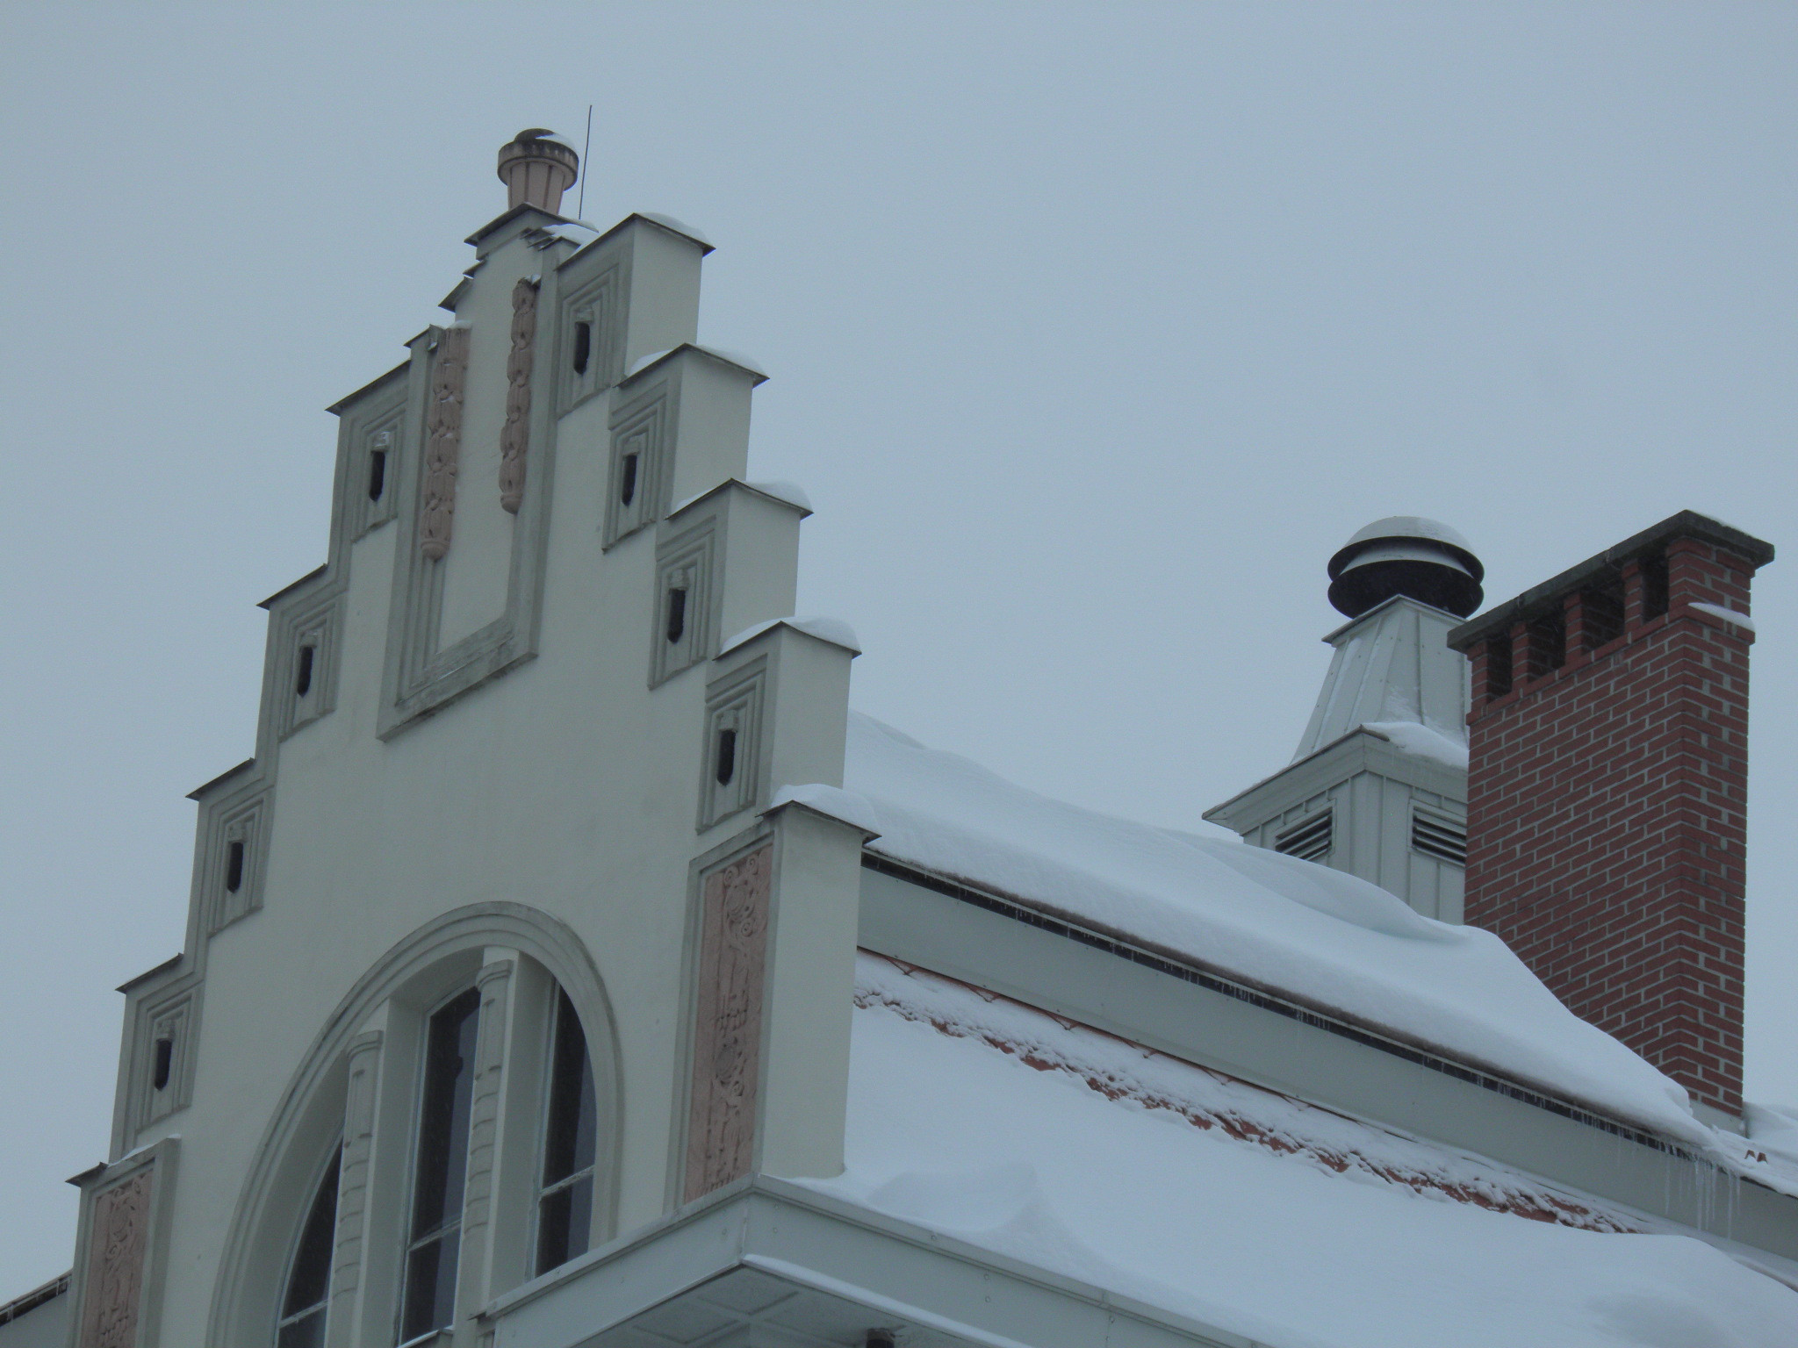

Slide 29
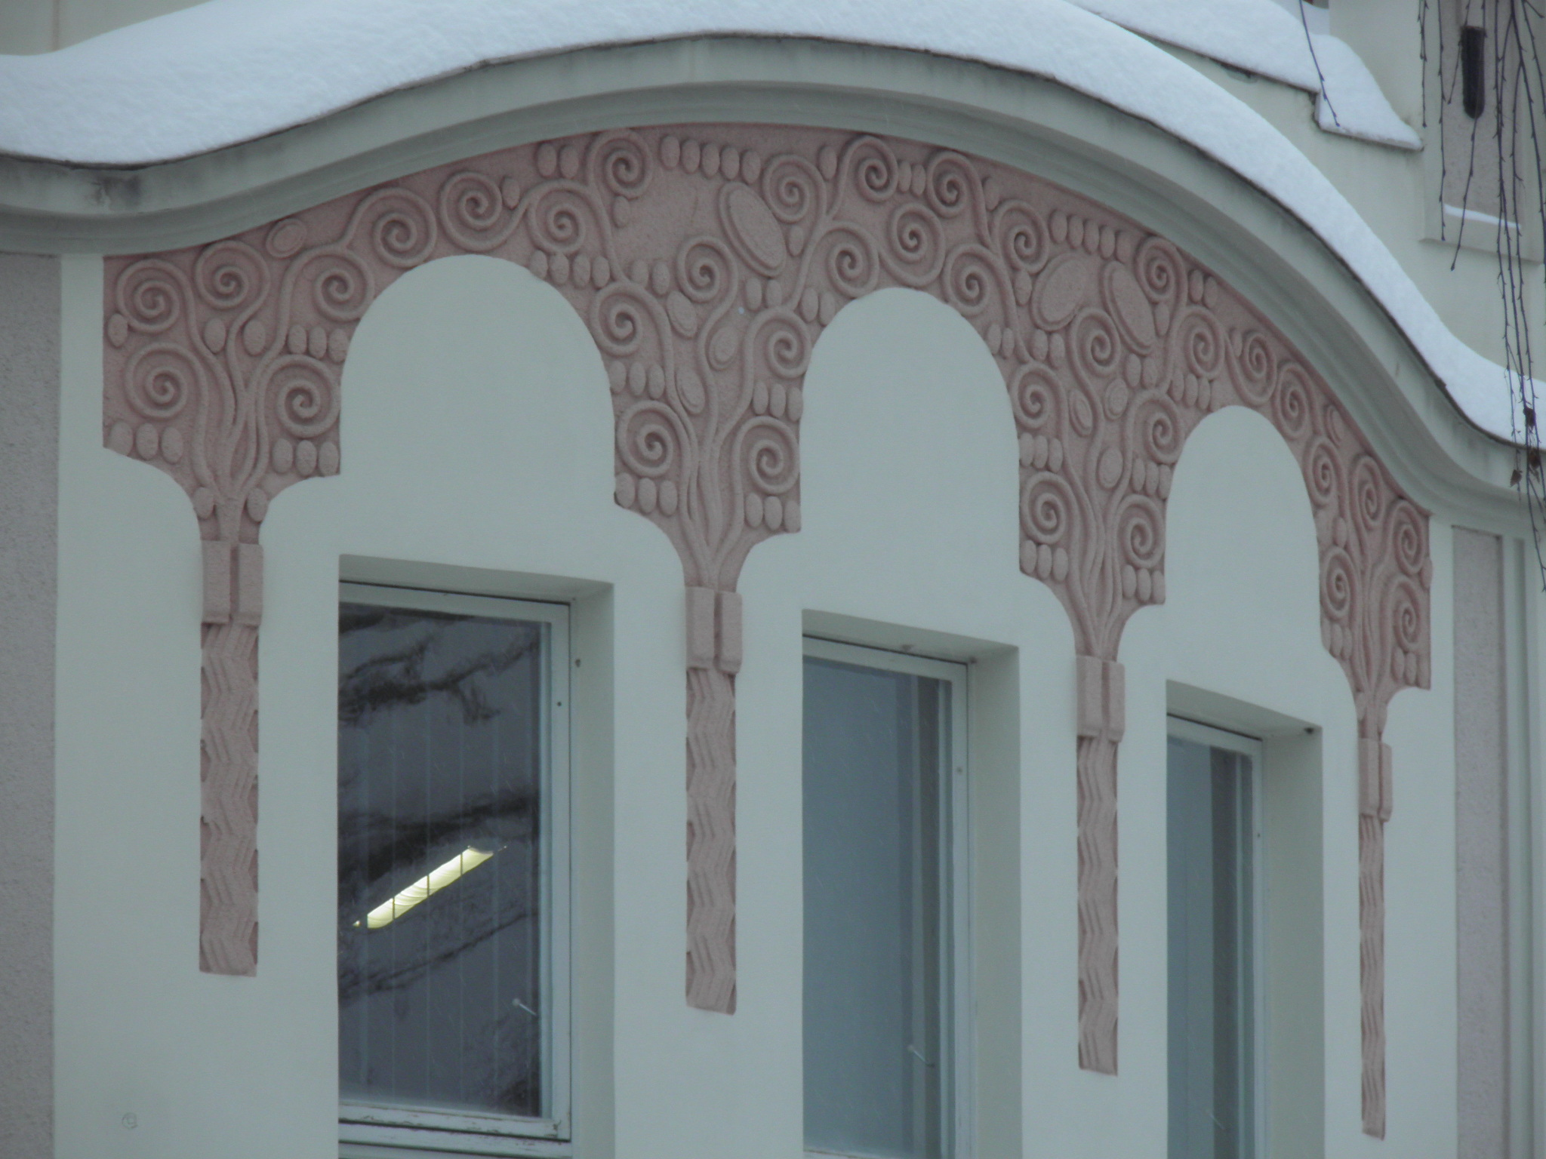

Slide 30
That‘s all, Folks!
See you all in Ceske Budejovice in March /April 2014!!!

