Slide 1
OUR SCHOOL:
Střední průmyslová škola stavební
Upper Secondary Technical School of Civil Engineering

Slide 2
WELCOME TO OUR SCHOOL!

Slide 3
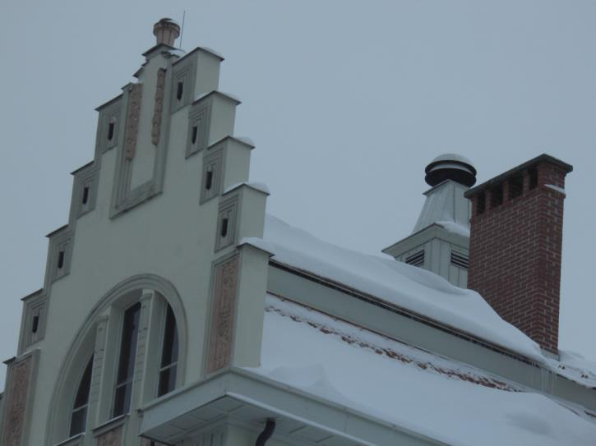

Slide 4
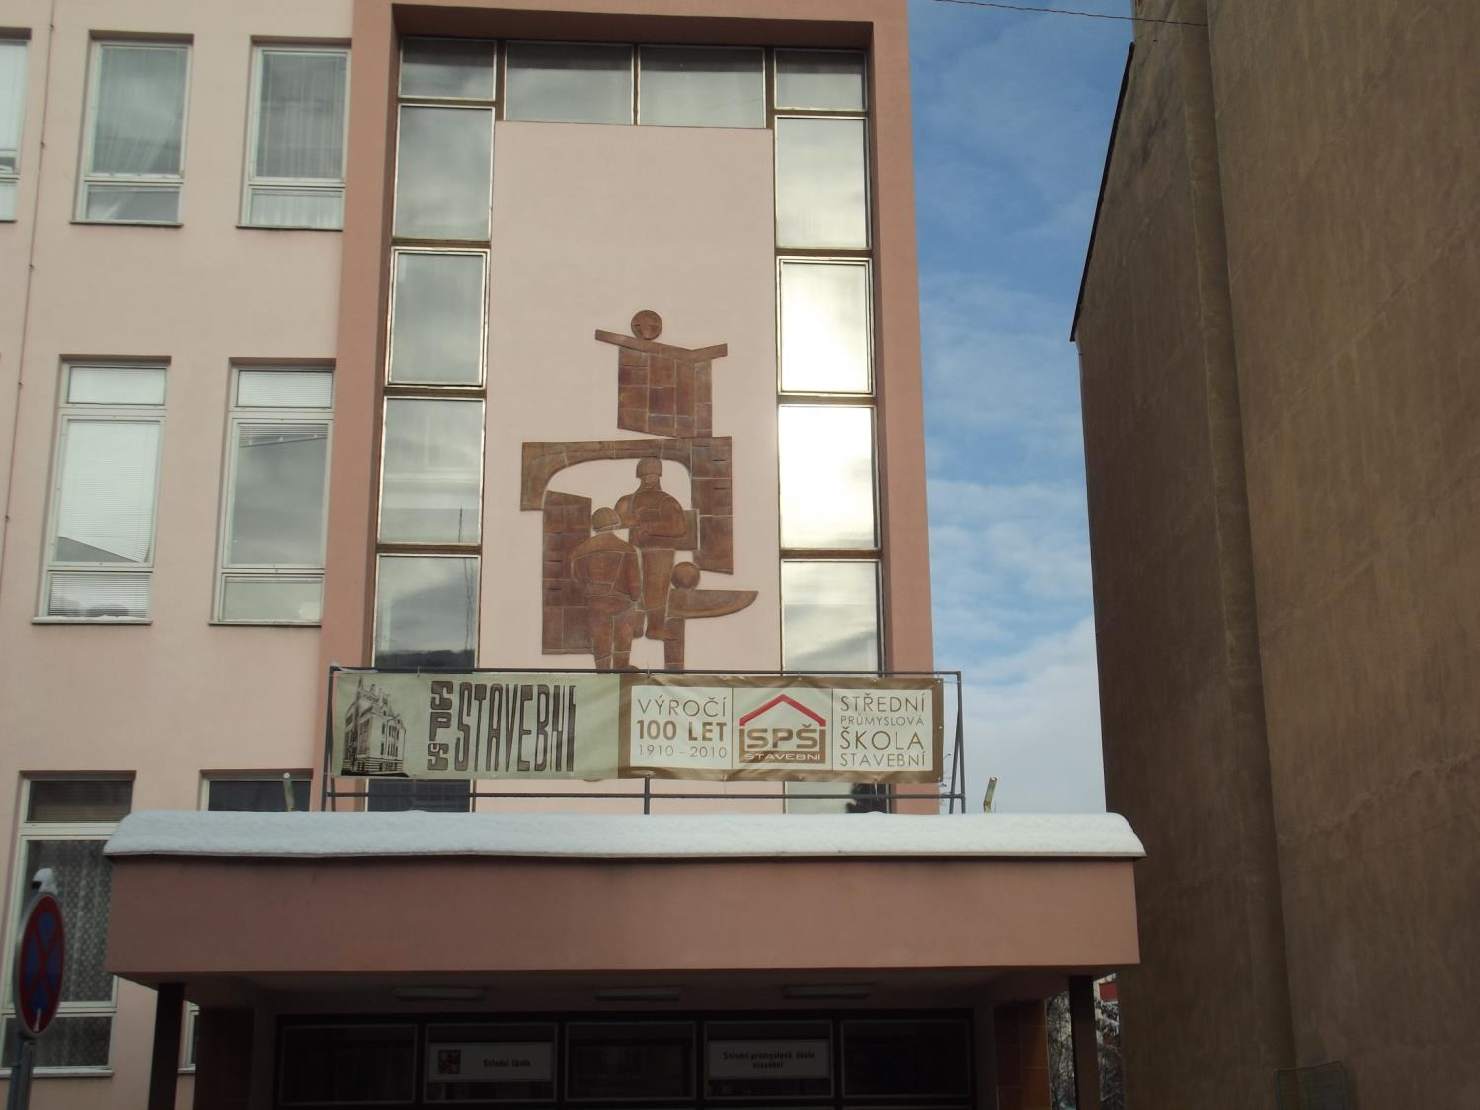

Slide 5
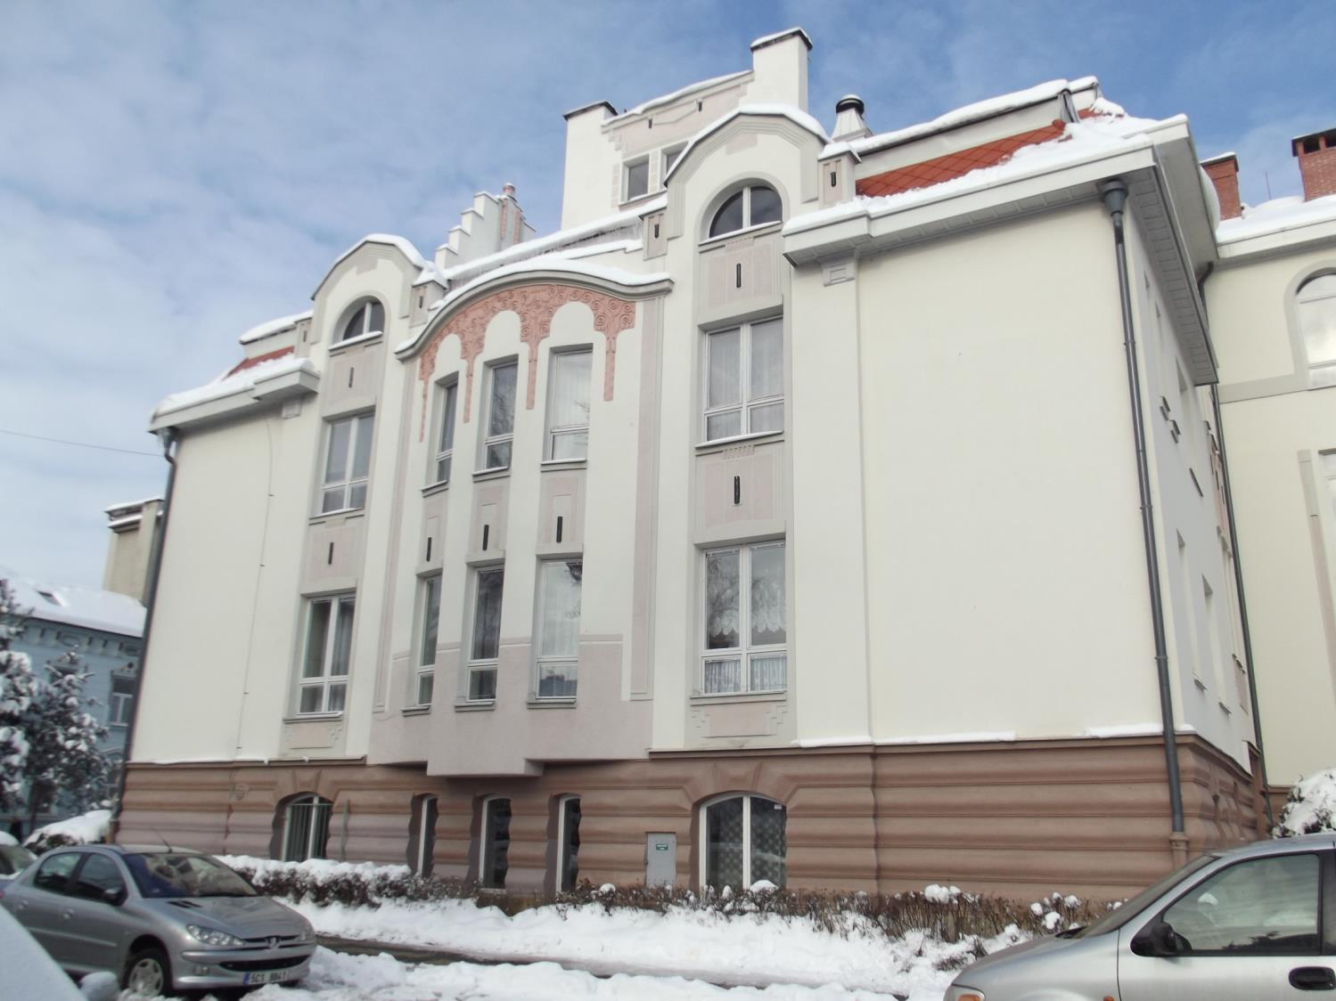

Slide 6
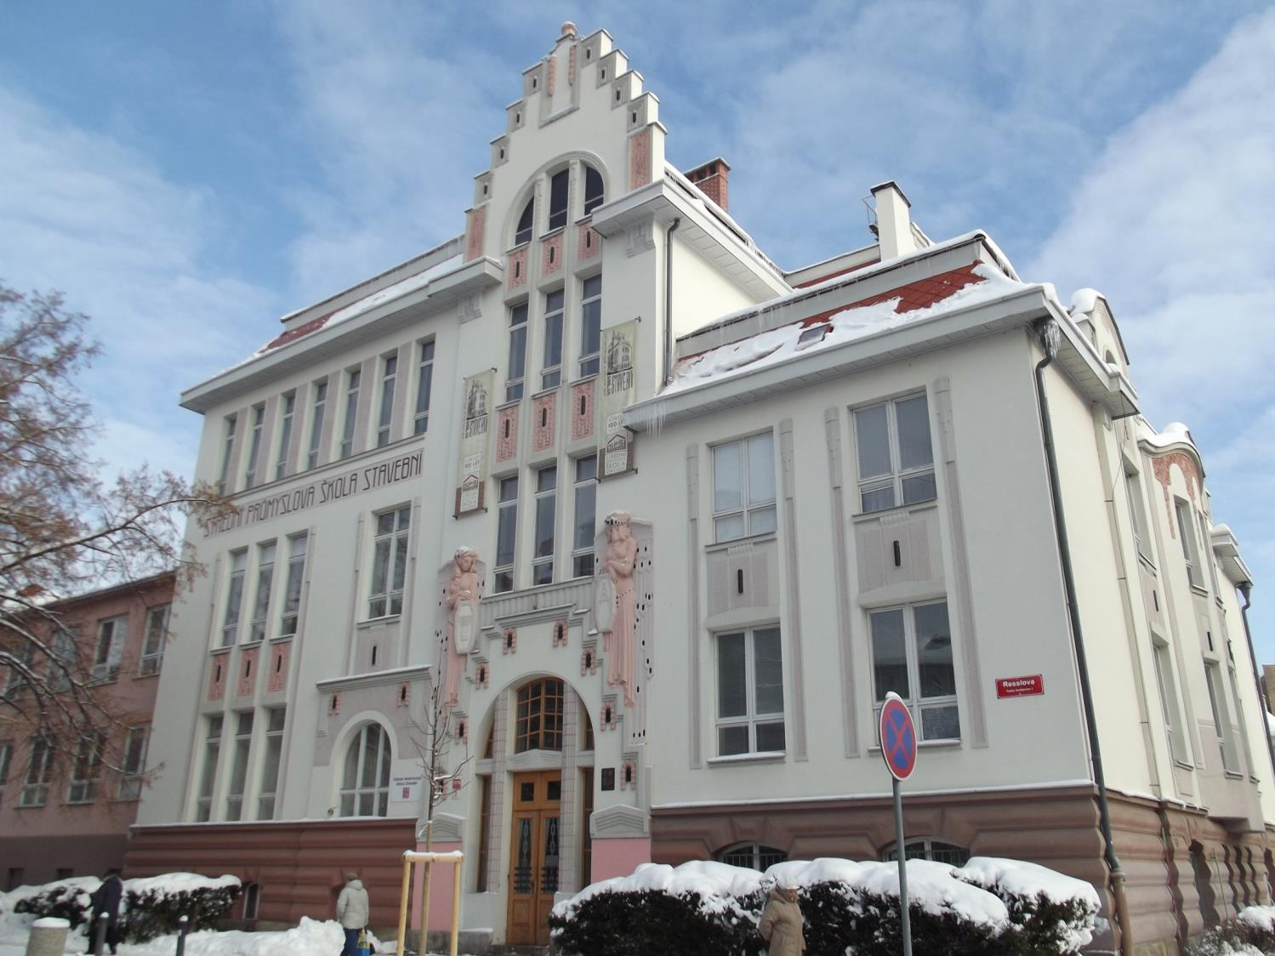

Slide 7
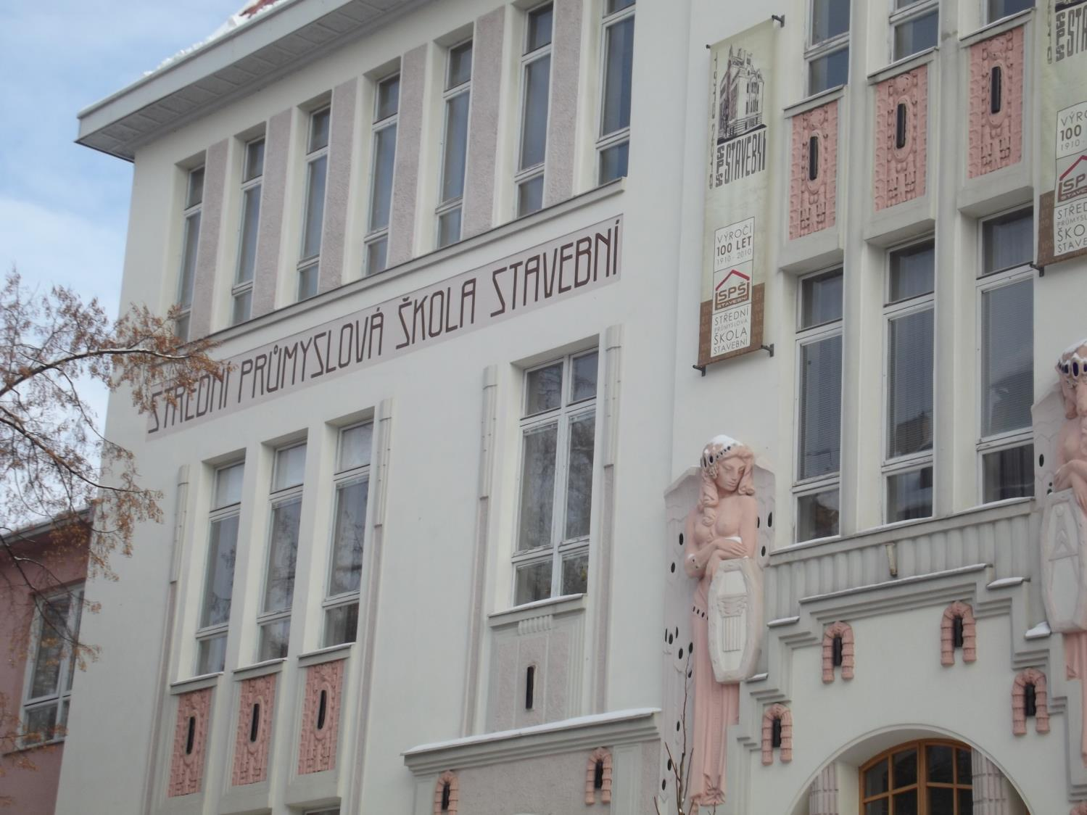

Slide 8
BASIC INFORMATION
Our school is in the centre of České Budějovice
It was opened in 1910, so it is more than 100 years old.
The building was designed by J. Pfeffermann.
It was built in the Art Nouveau style.

Slide 9
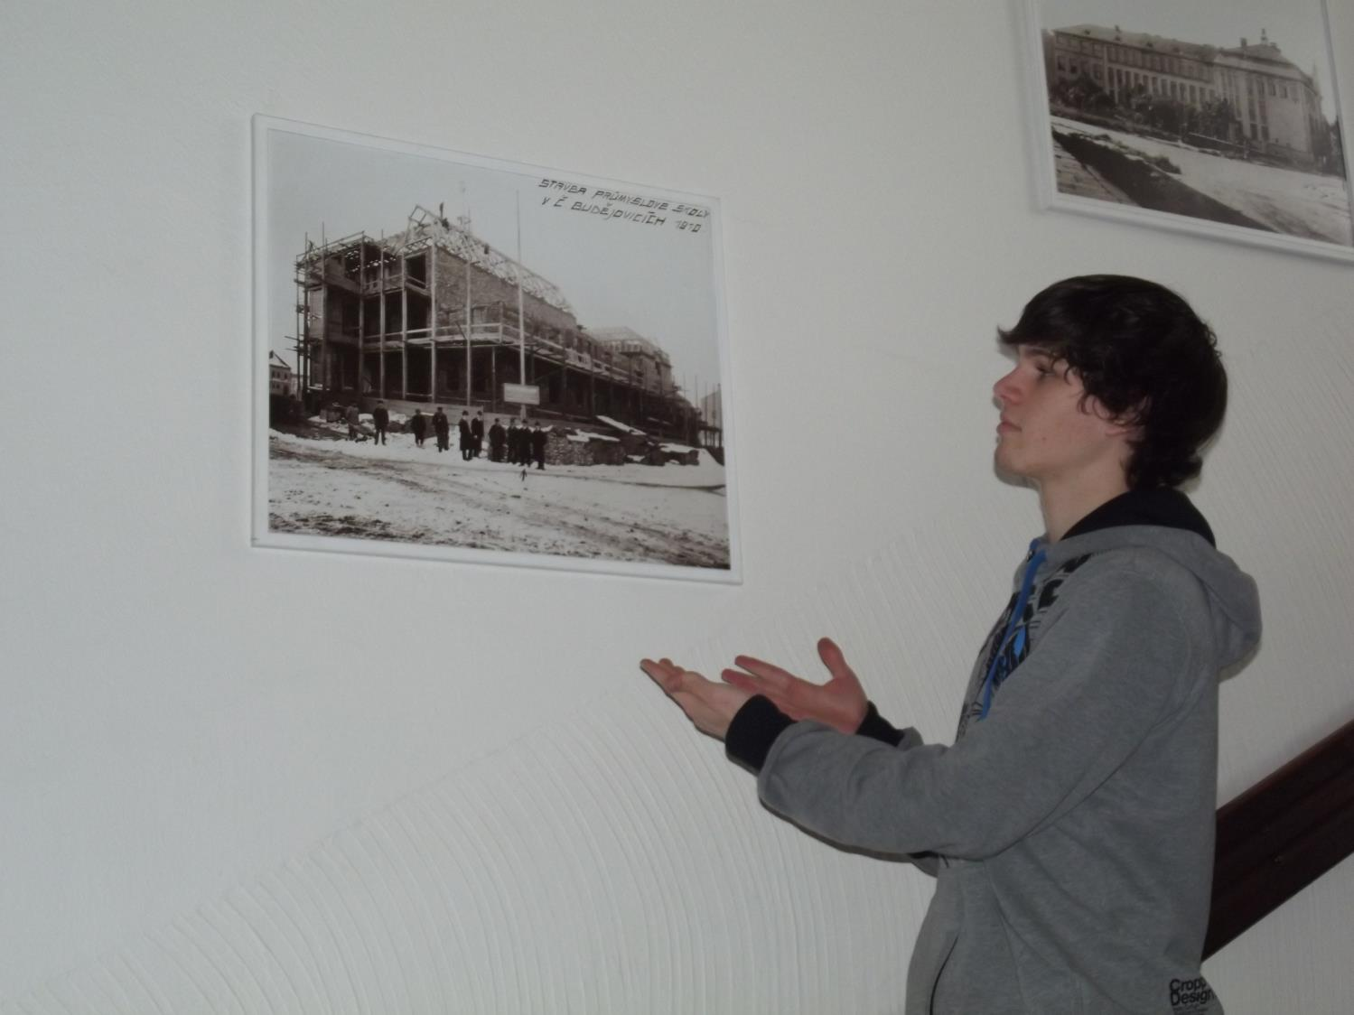

Slide 10
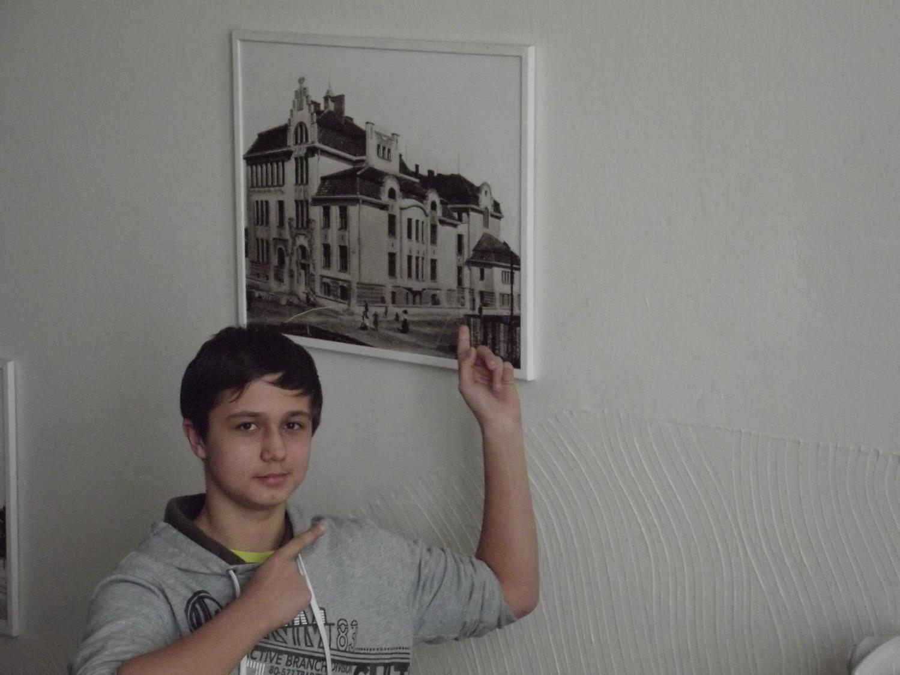

Slide 11
SCHOOL IN NUMBERS
513 students study here this year
47 teachers teach here this year
25 classes are here this year
46 subjects are taught here this year
6 fields of study are here this year
Auditorium seats 110 listeners … every year

Slide 12
OUR DAY

Slide 13
We go from ,,school hostel“ to school in the morning

Slide 14
It is our entrance

Slide 15
We are closer to school… ☺

Slide 16
Our next stop is in the locker room ☺

Slide 17
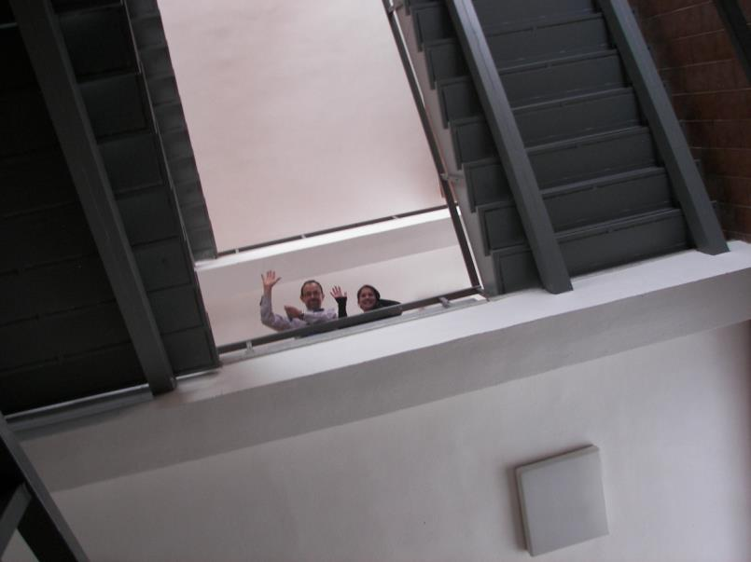
On the way to our classroom

Slide 20
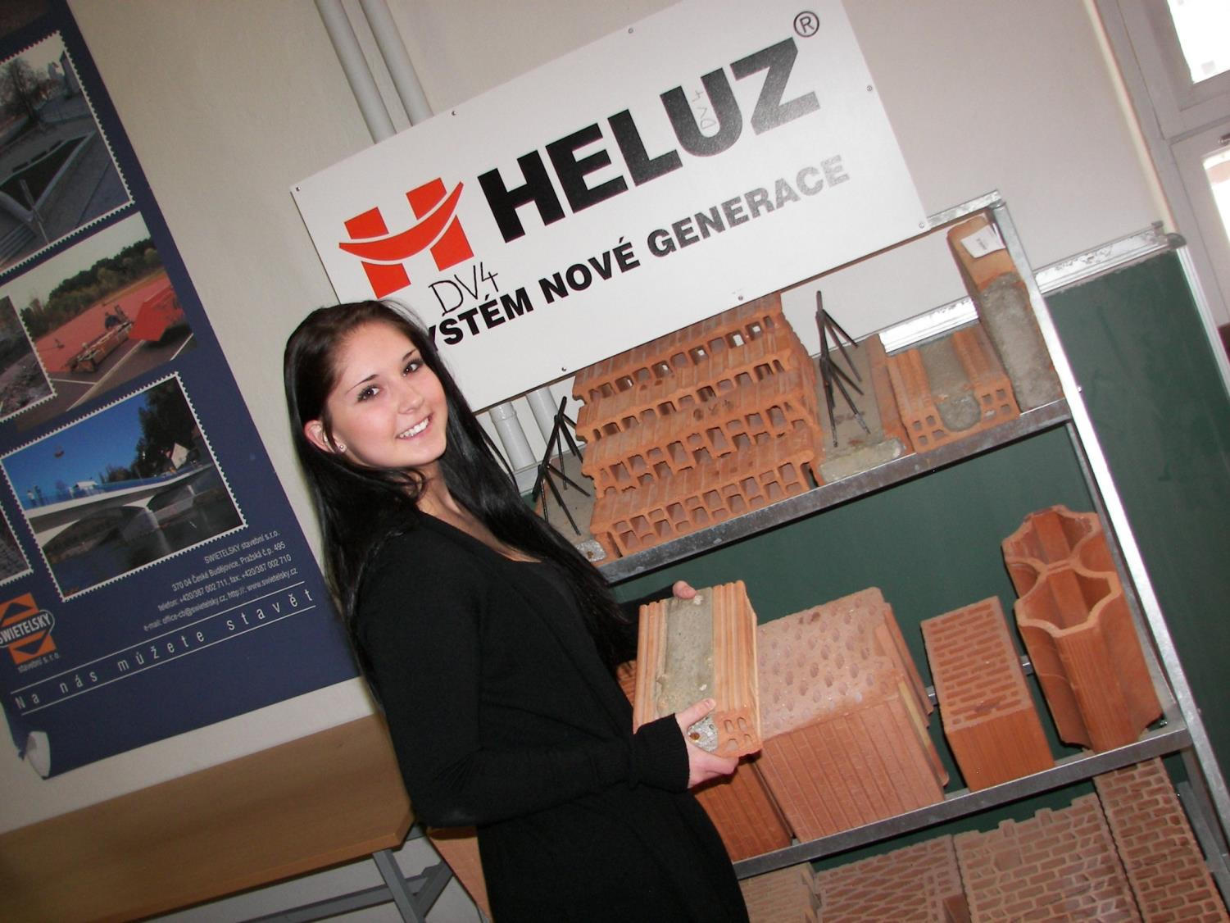

Slide 21
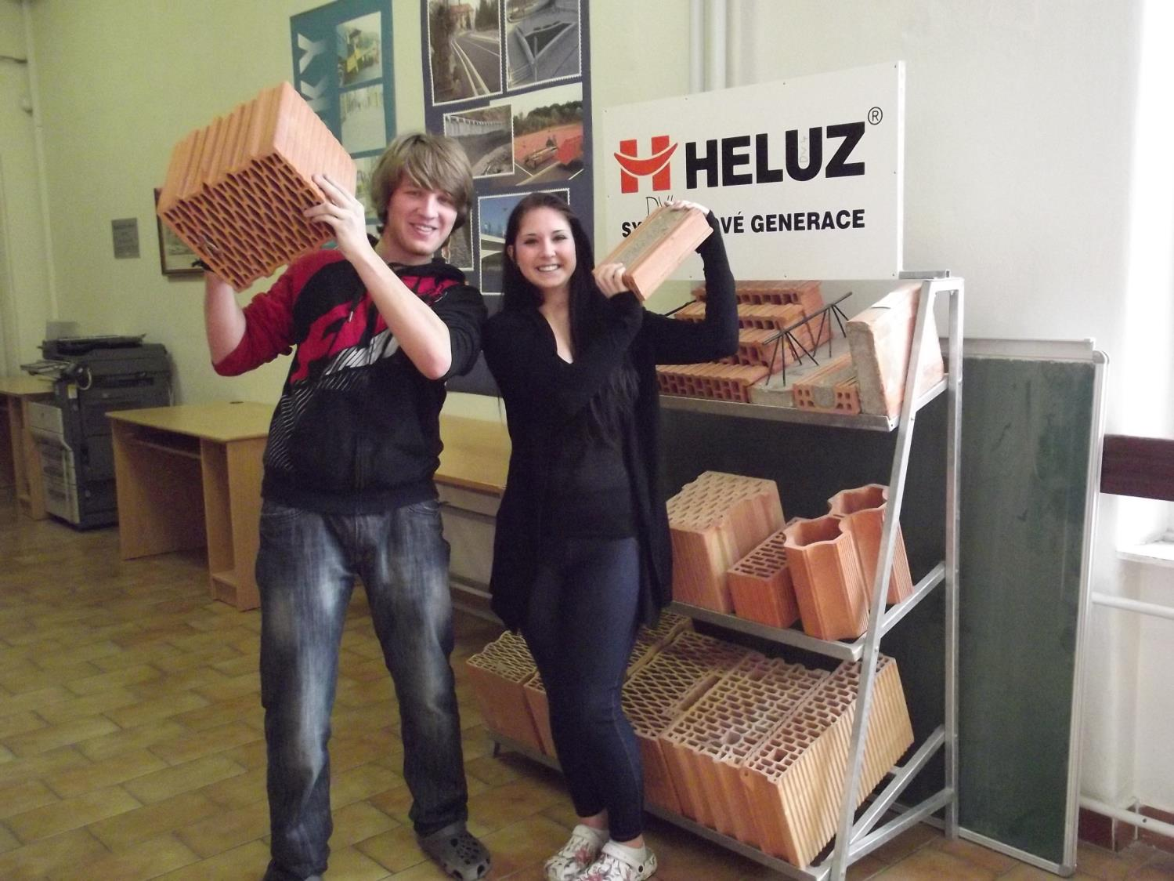

Slide 22
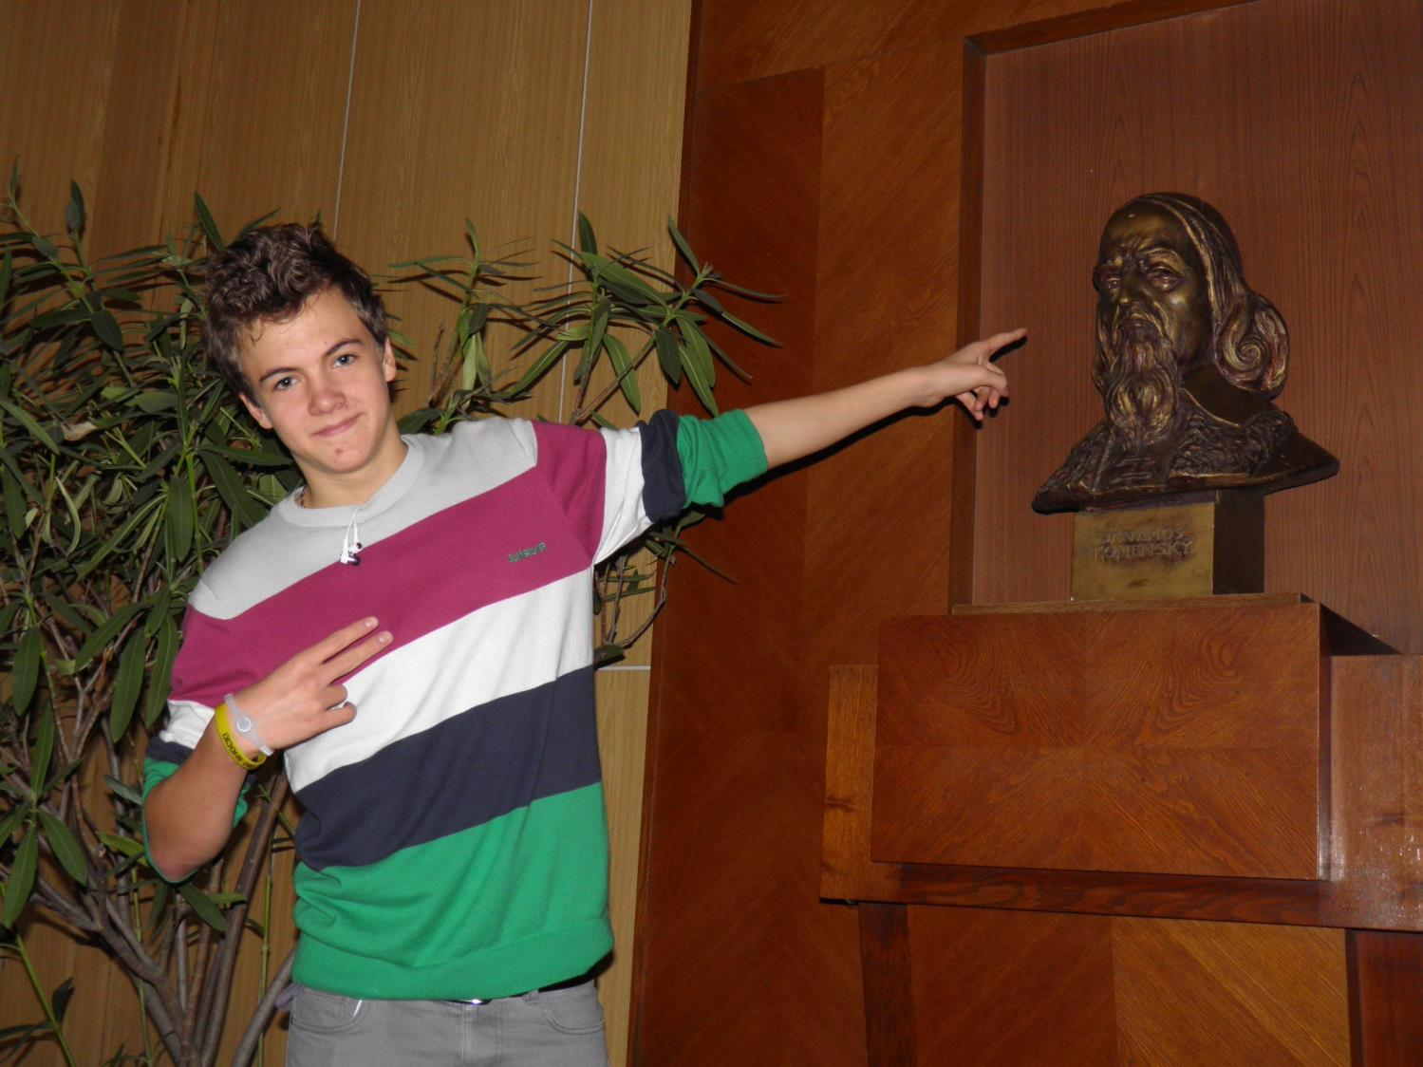

Slide 23
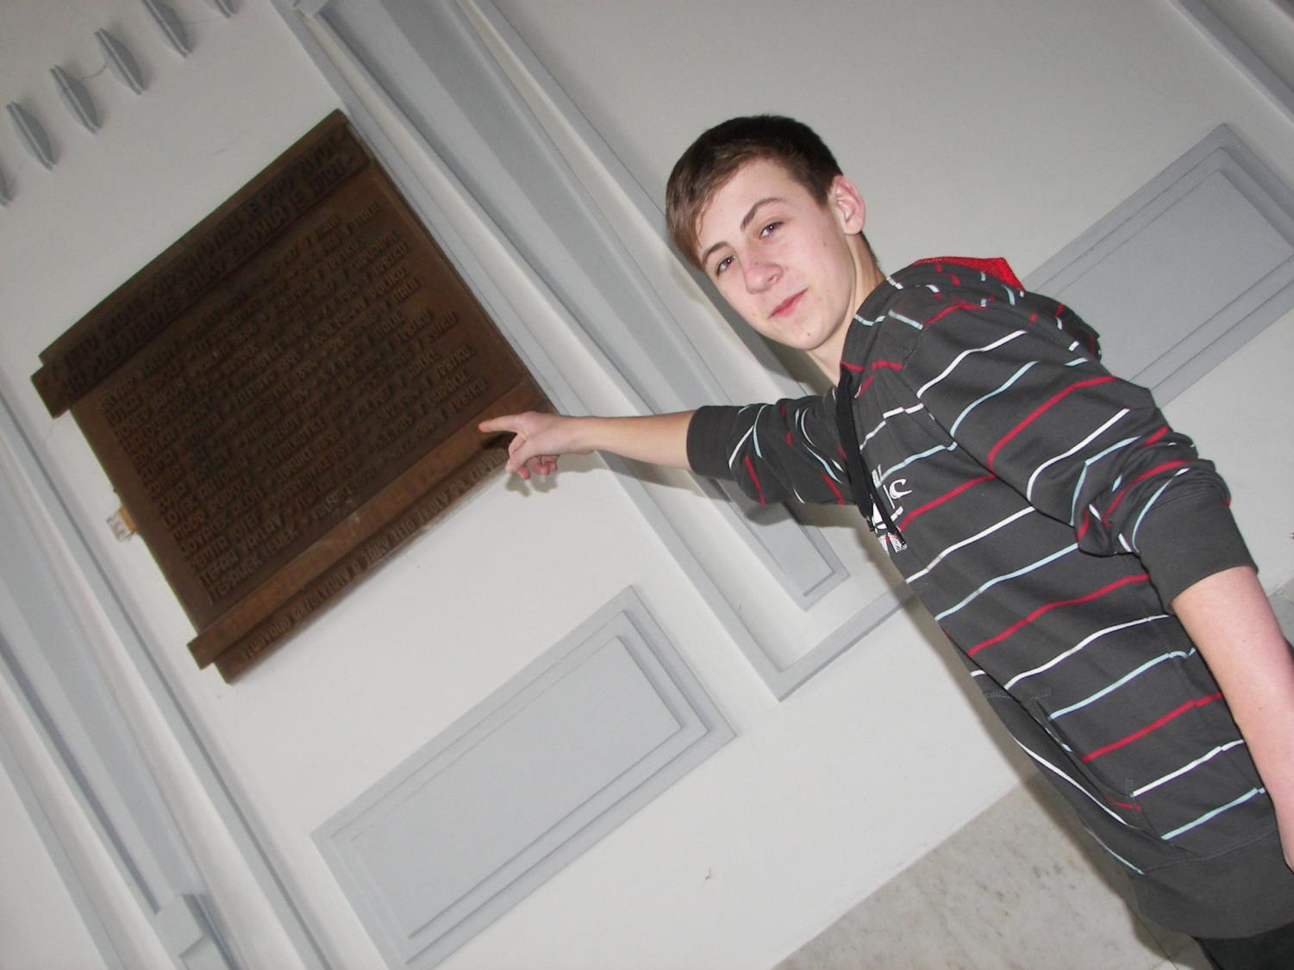

Slide 24
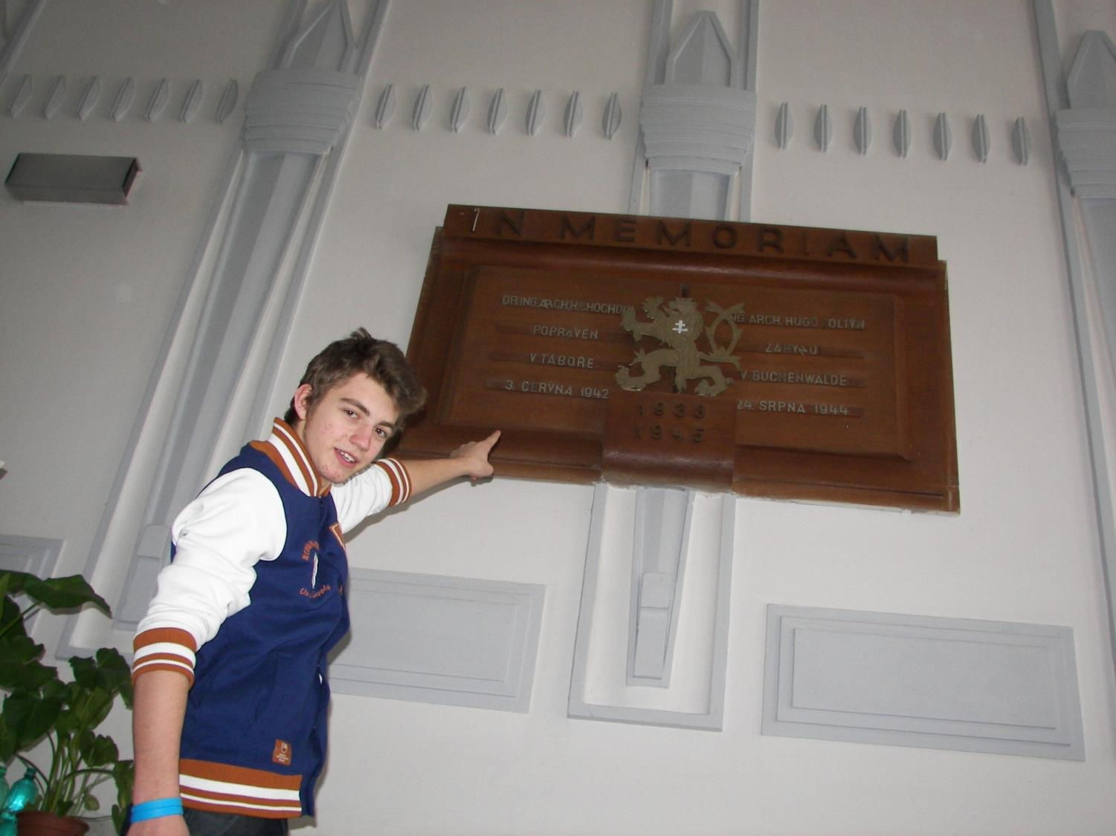

Slide 25
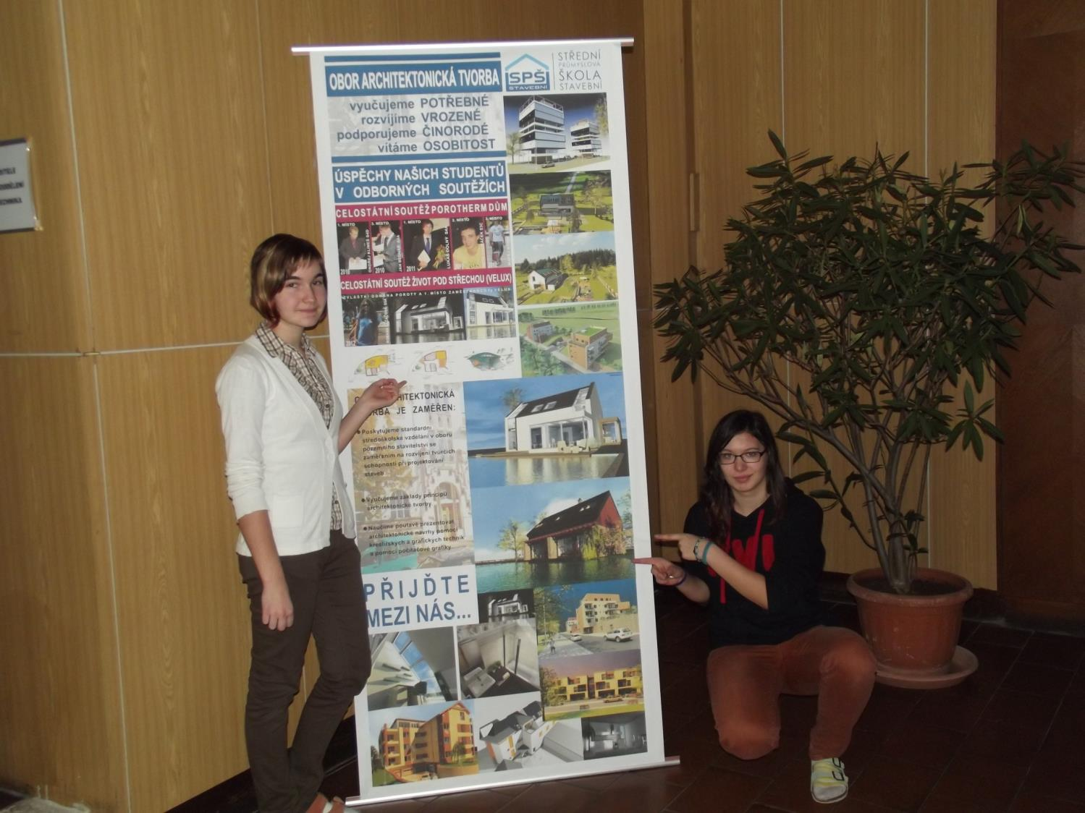

Slide 26
We are finally in the classroom

Slide 27
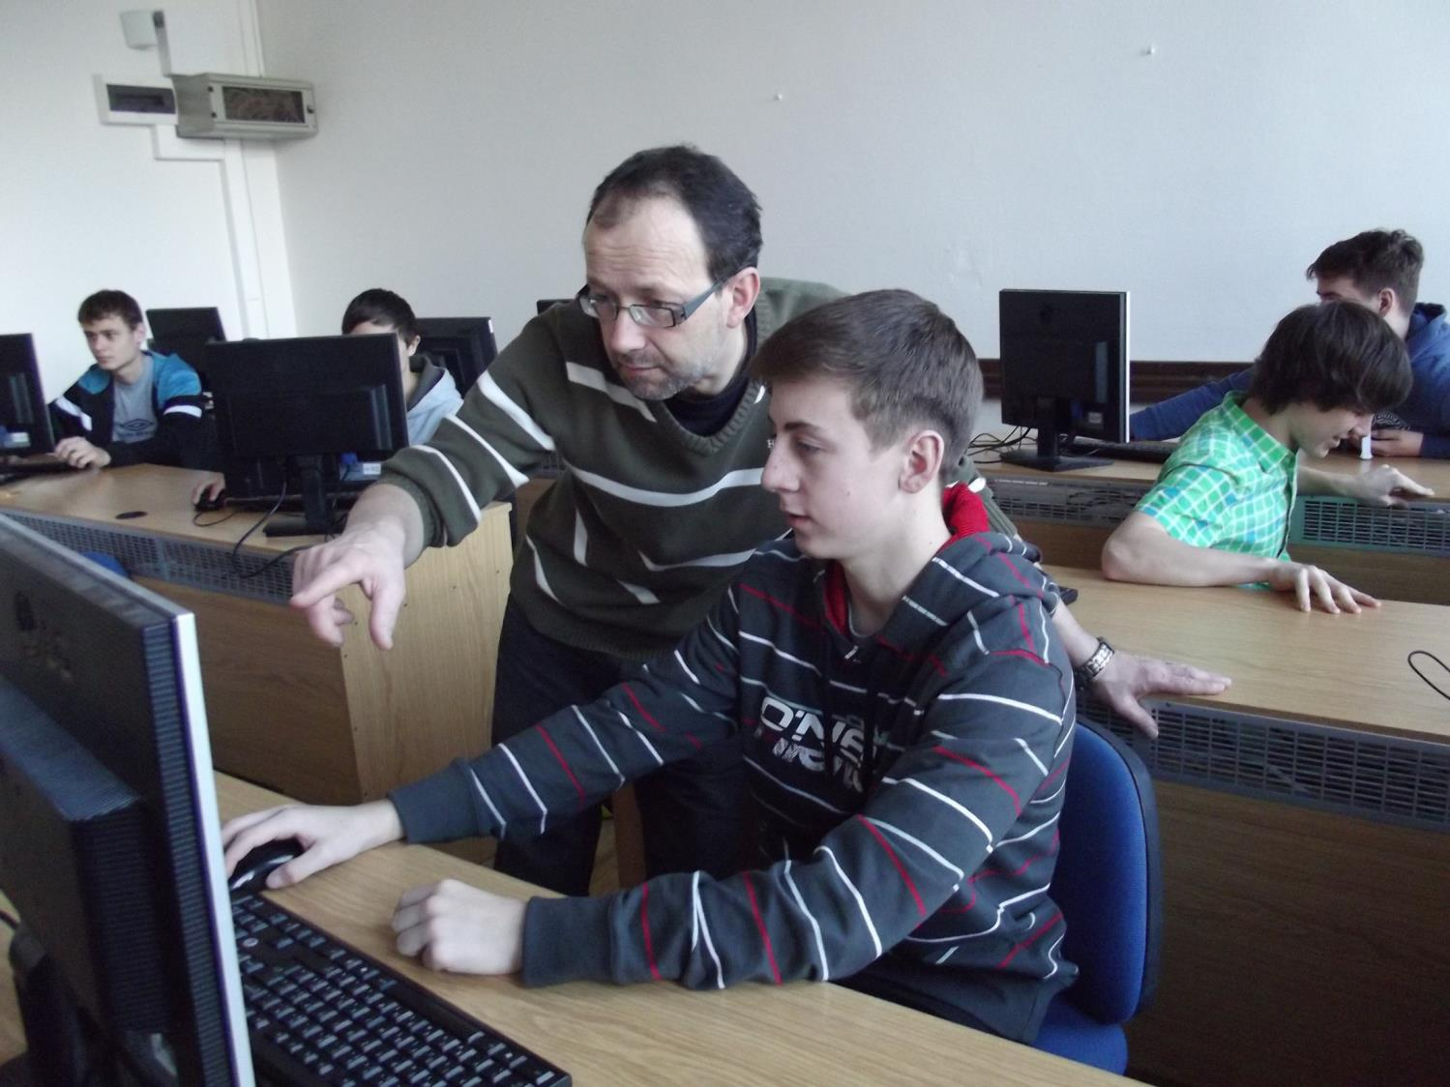

Slide 28
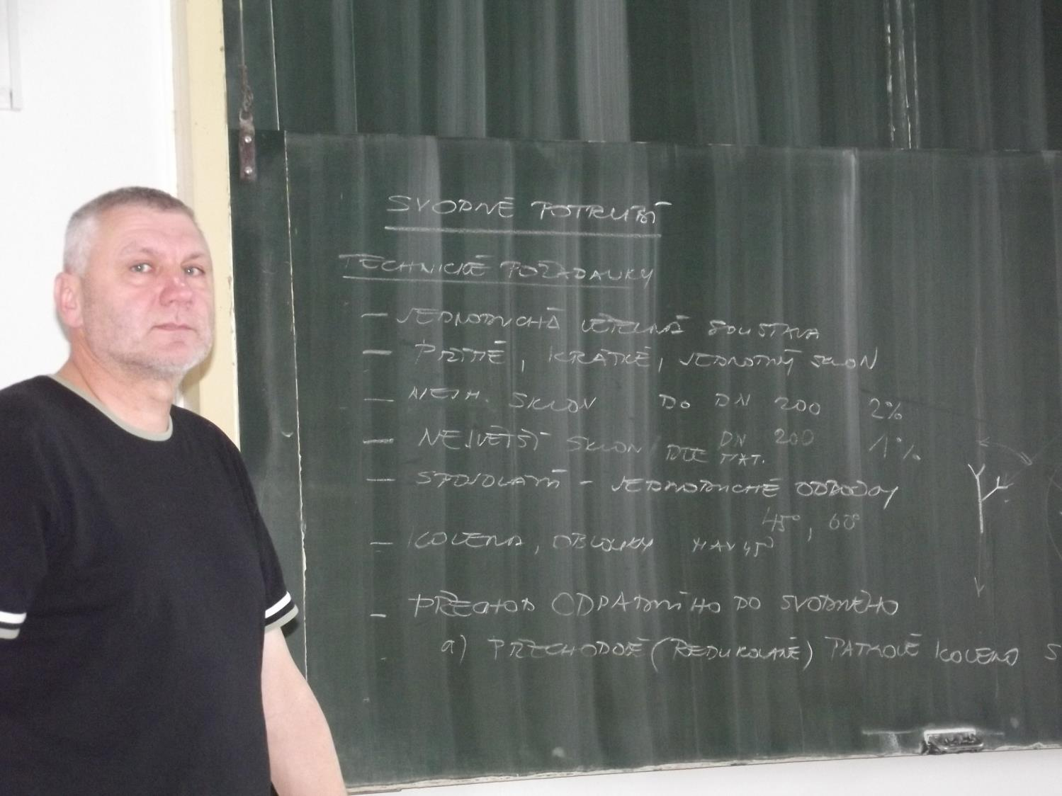

Slide 29
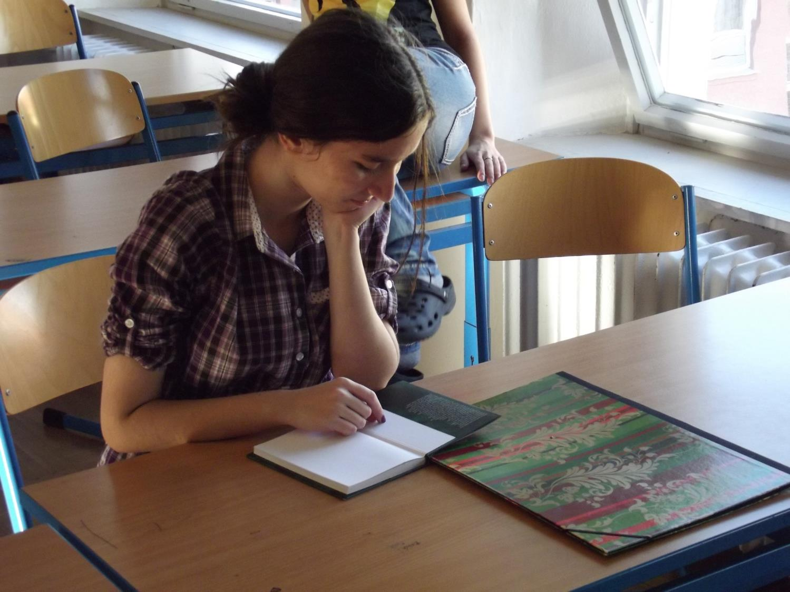

Slide 30
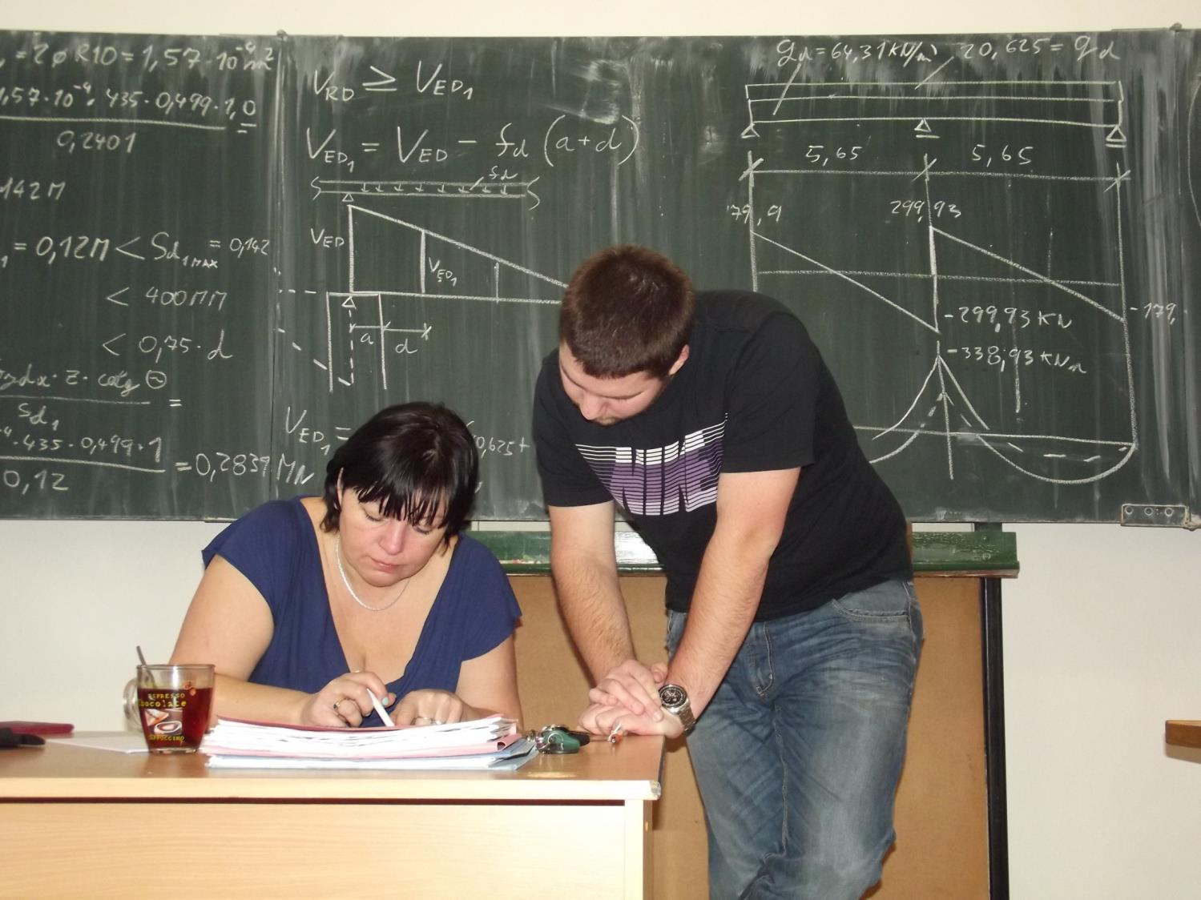

Slide 31
A typical break scene …

Slide 32
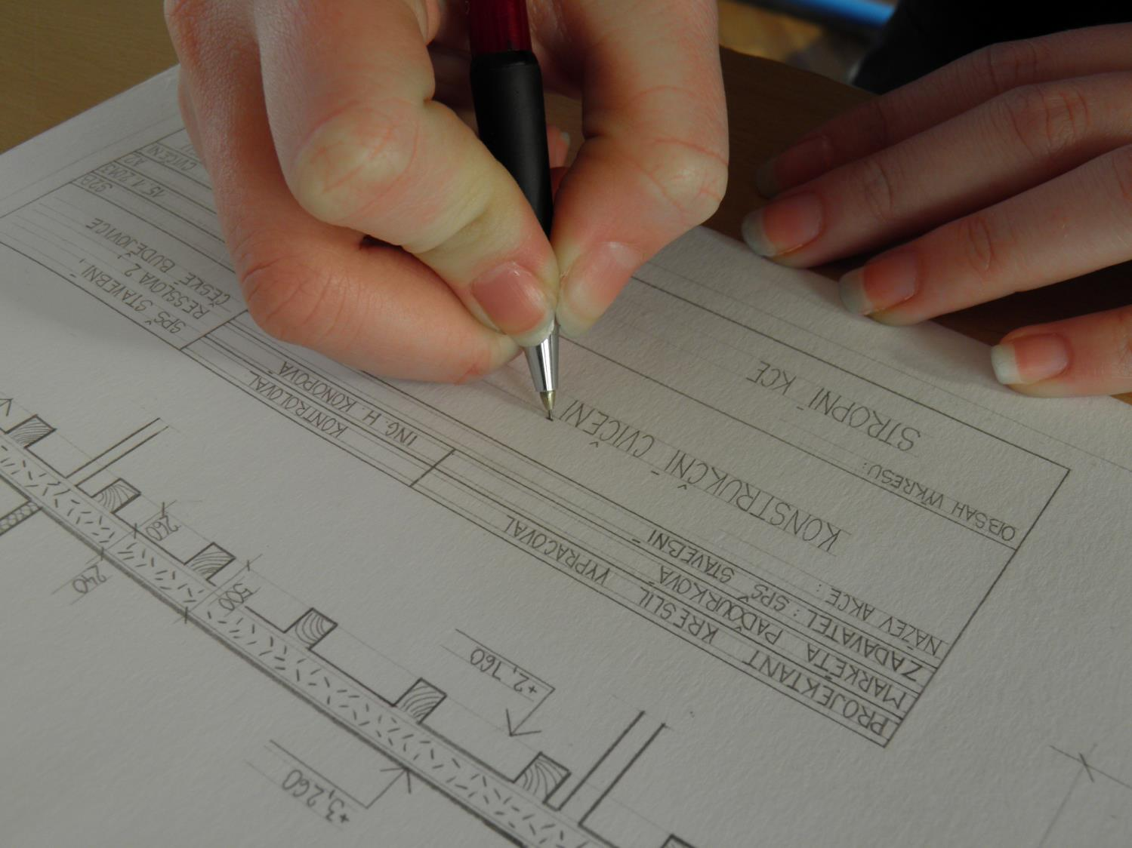

Slide 33
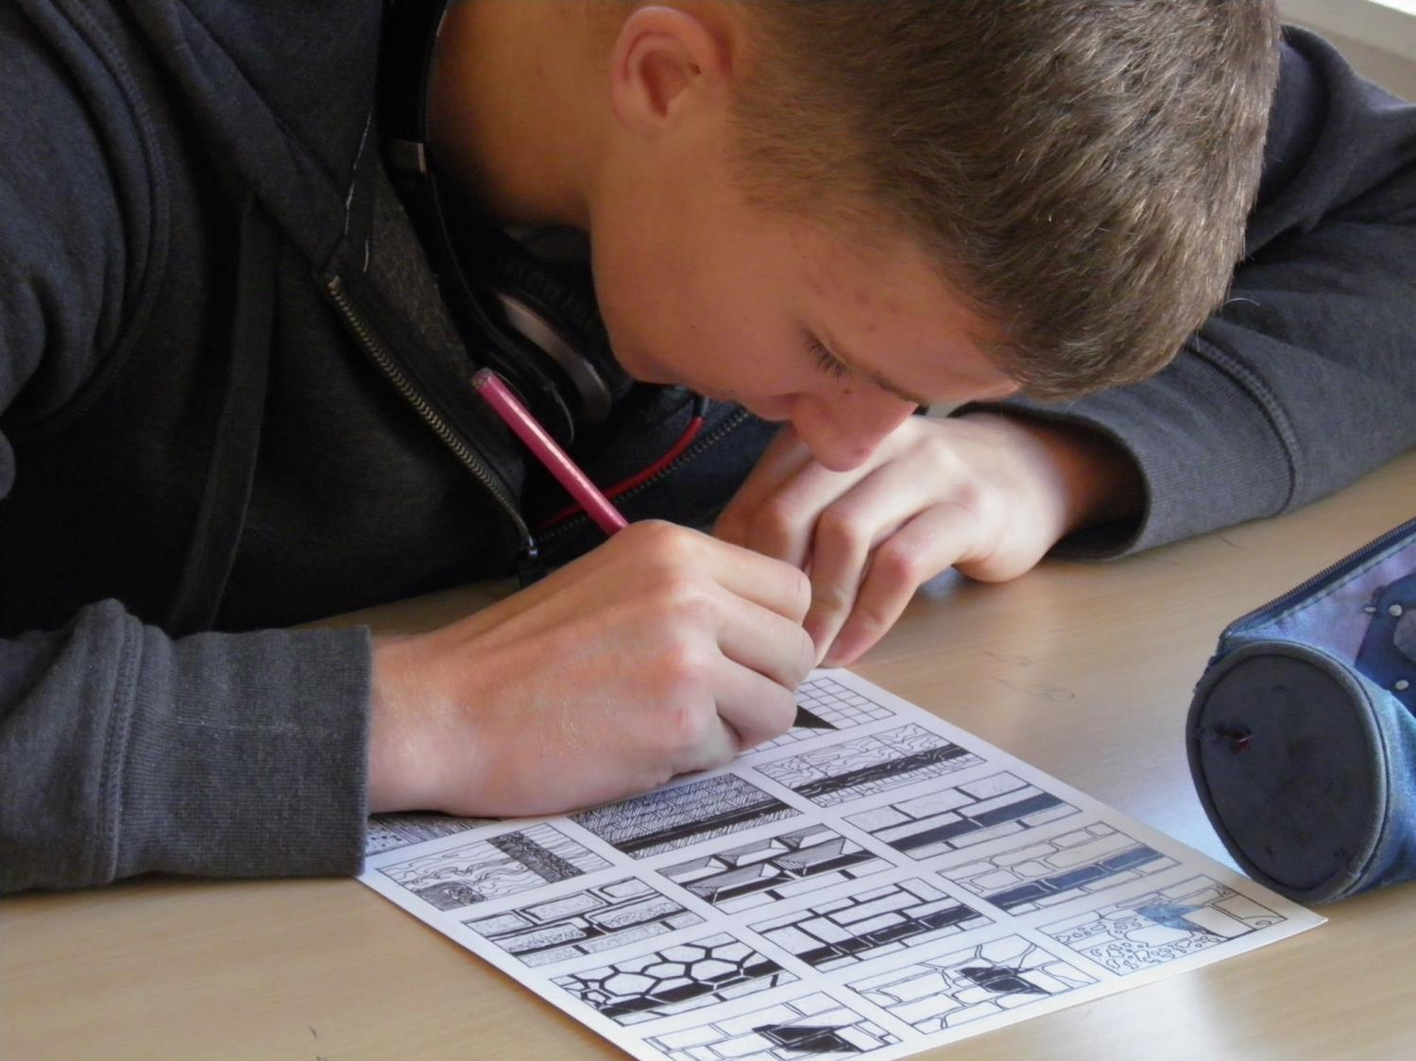

Slide 34
Physical Education

Slide 35
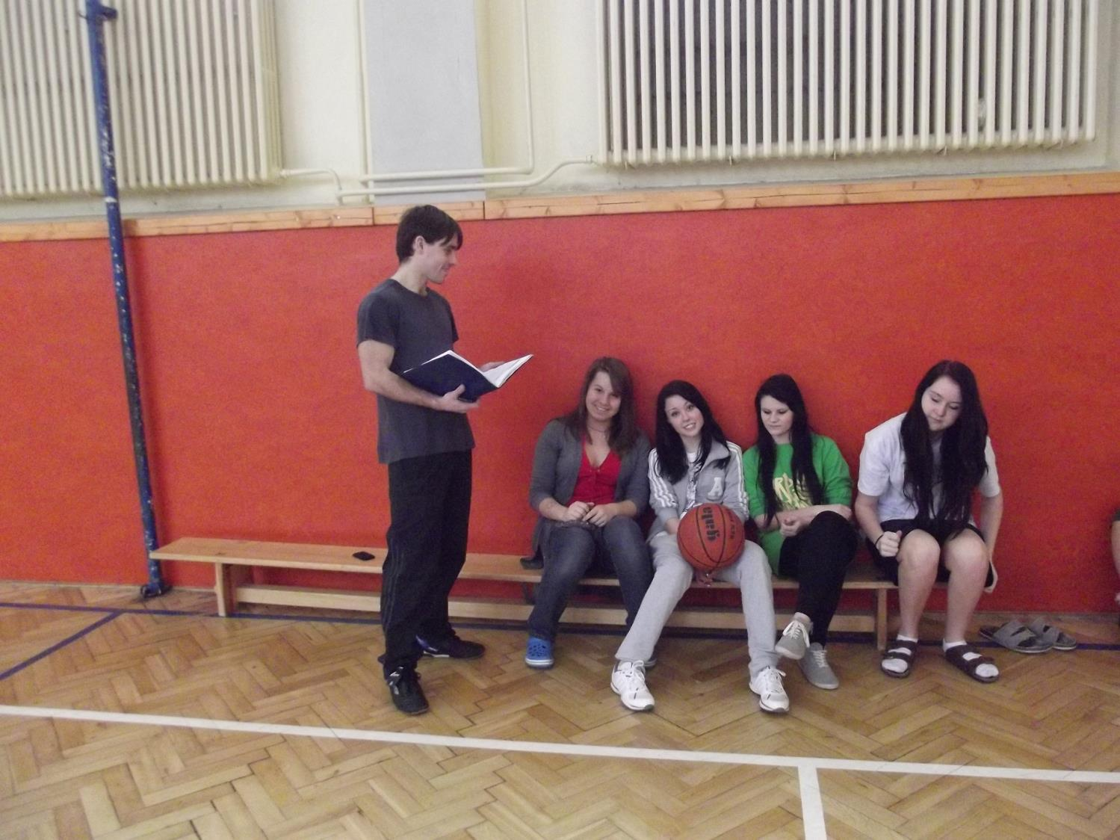

Slide 36
Library

Slide 37
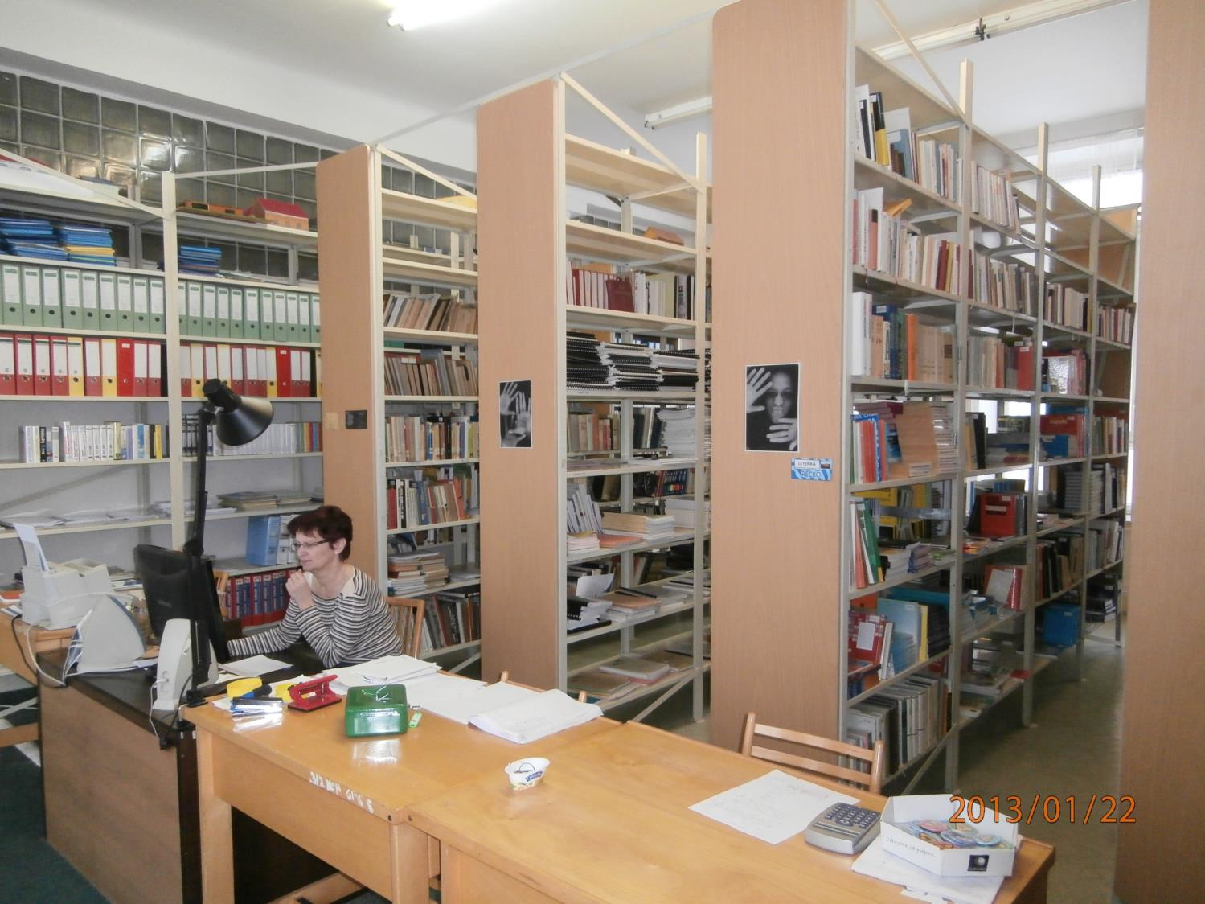

Slide 38
On the top floor…

Slide 39
…is an atelier

Slide 40
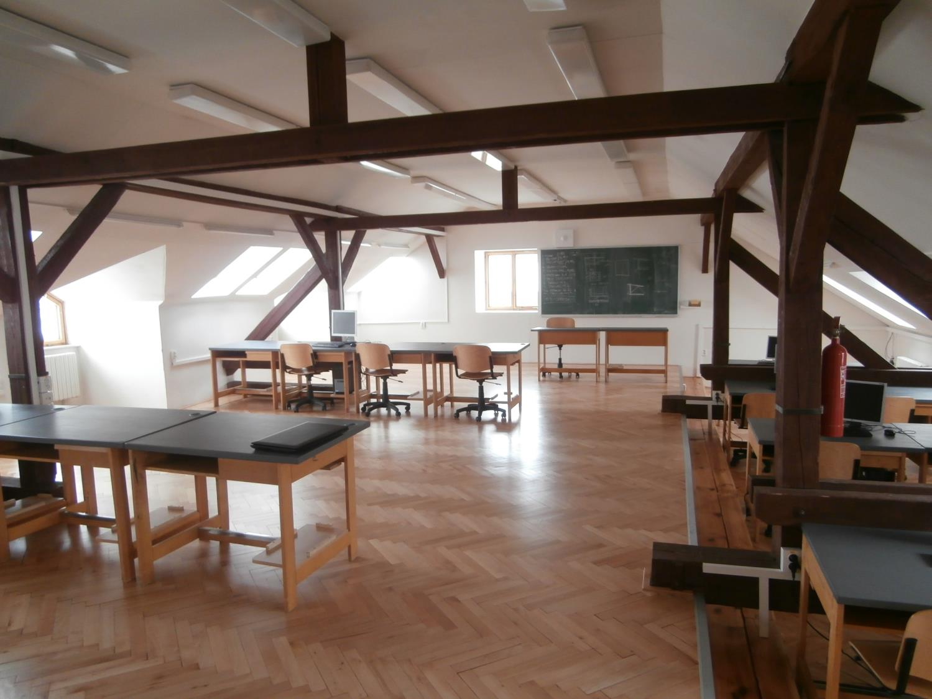

Slide 41
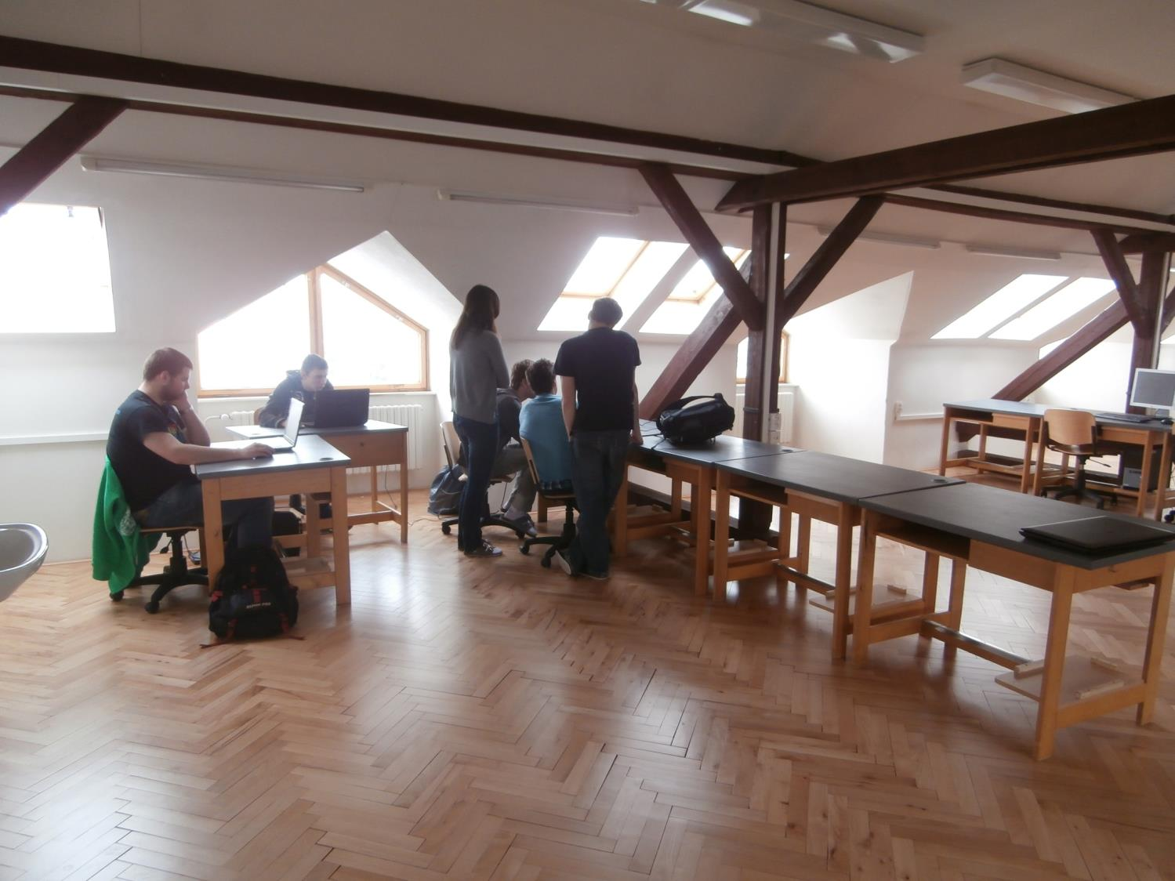

Slide 42
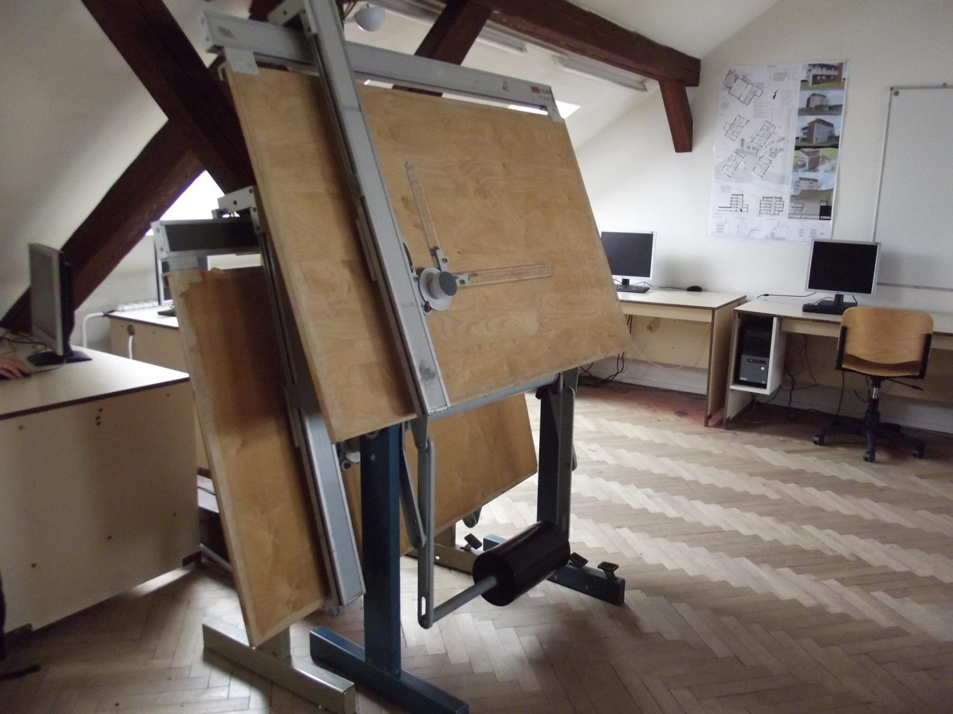

Slide 43
We haven‘t just theory ☺

Slide 44
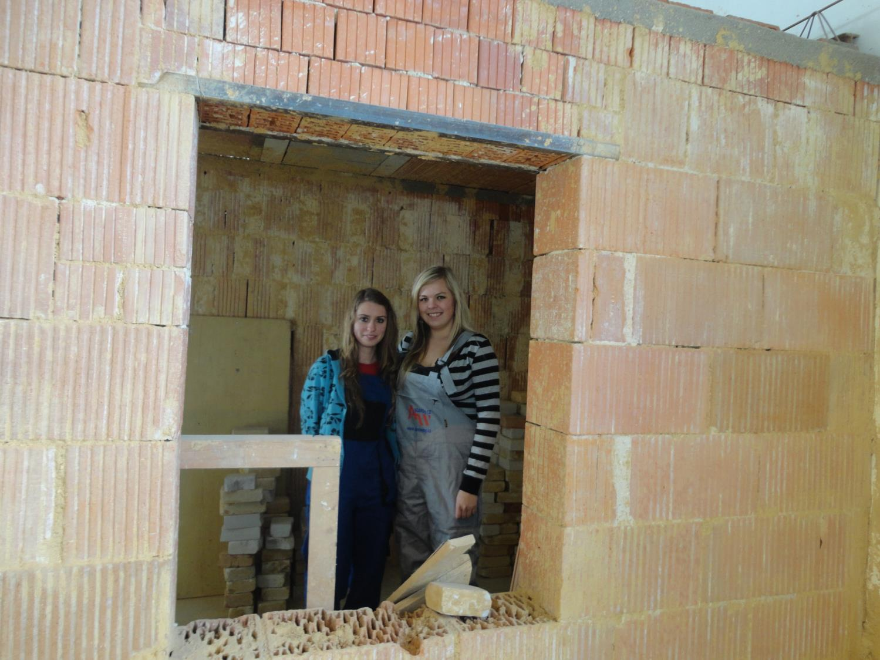

Slide 45
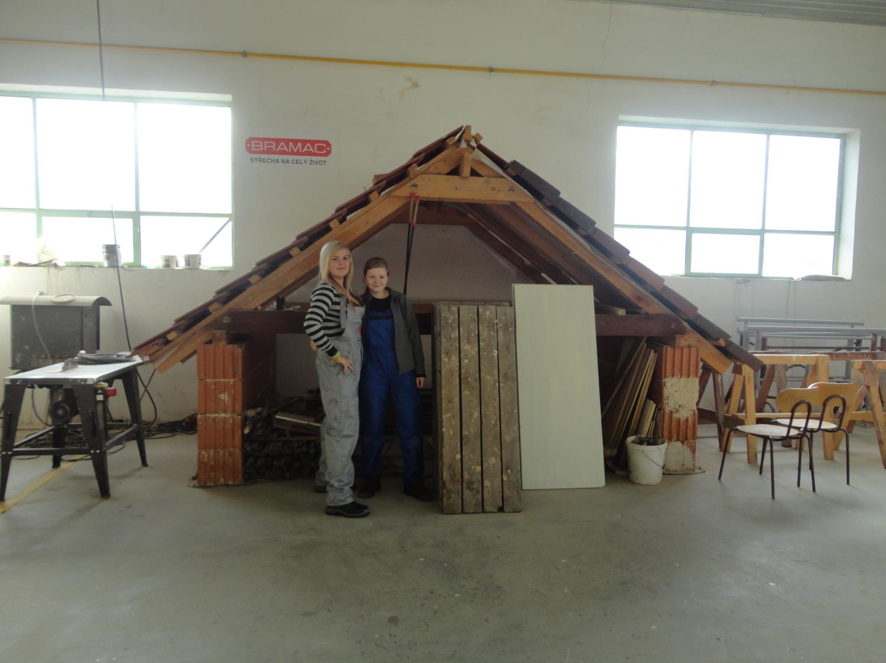

Slide 46
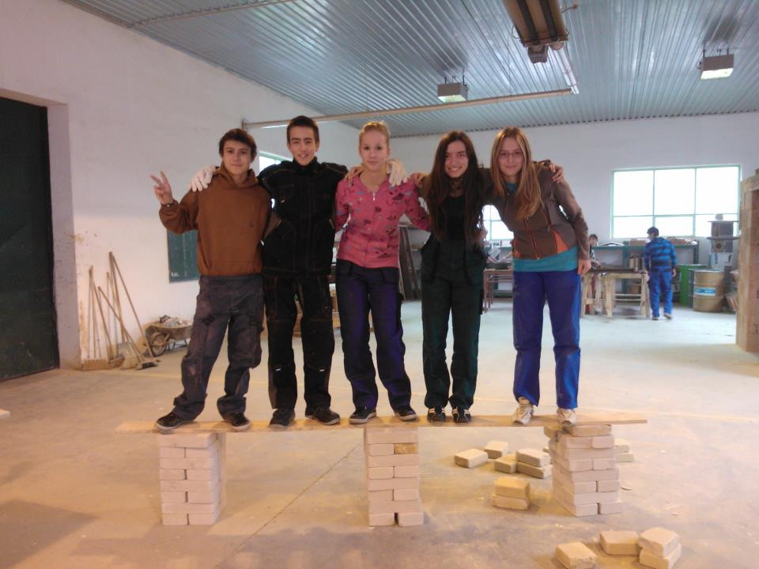

Slide 47
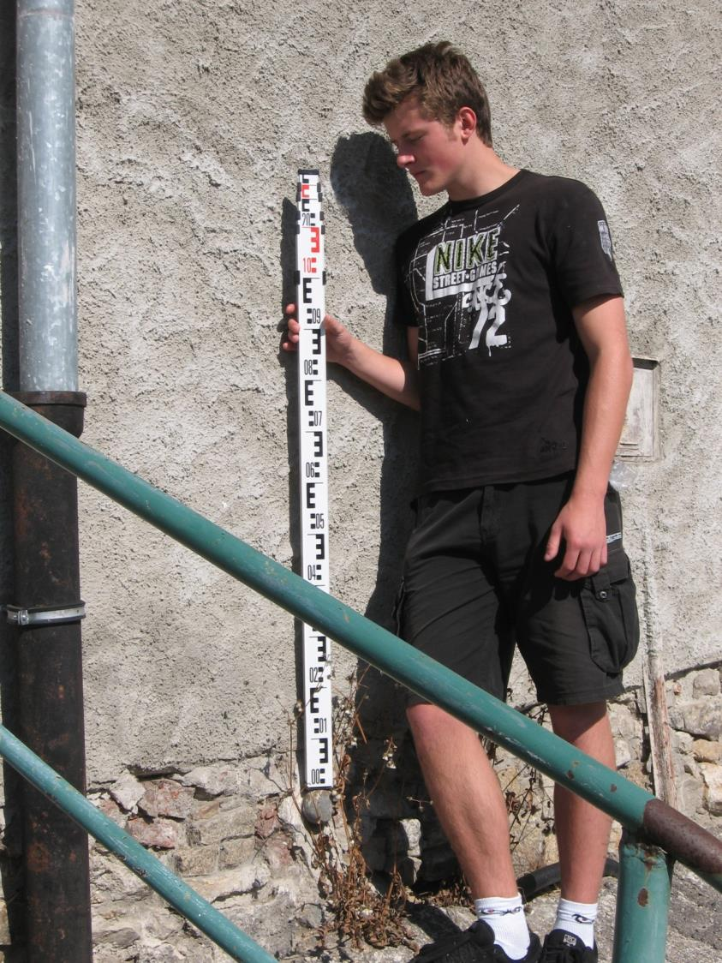

Slide 48
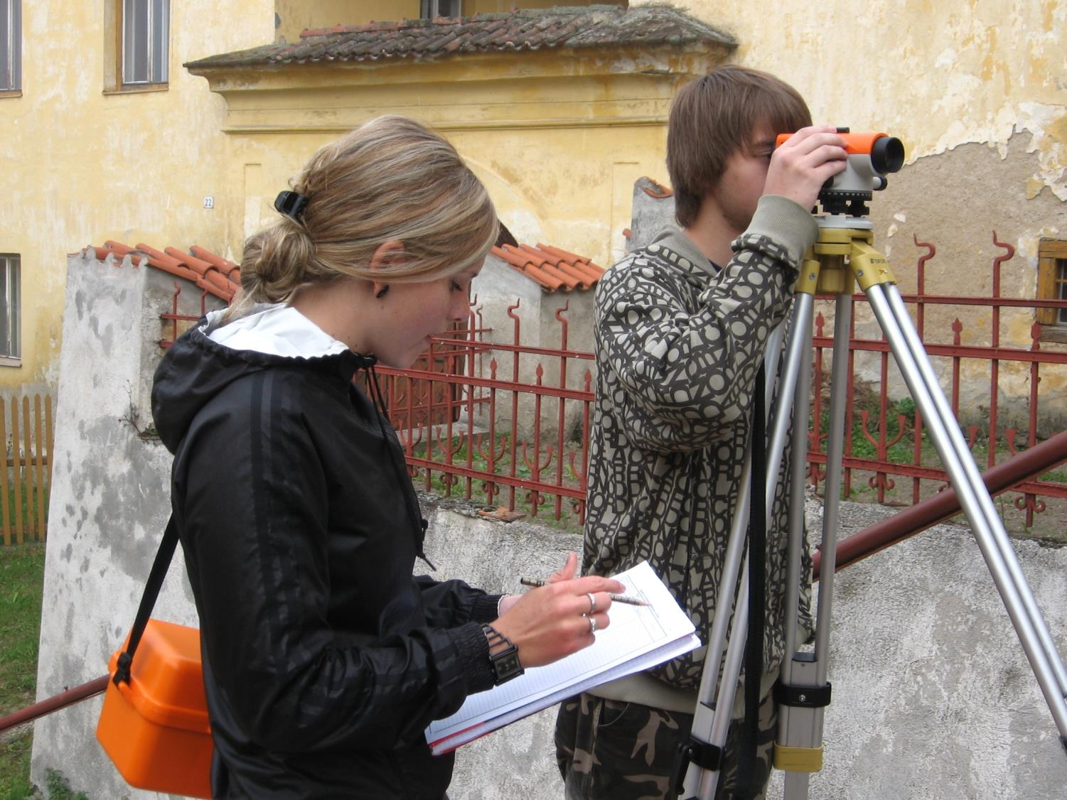

Slide 49
When we are in trouble, we go here first, to the office …

Slide 50
…and then to the BIG BOSS ☺

Slide 51
ACTIVITIES AT SCHOOL

Slide 52
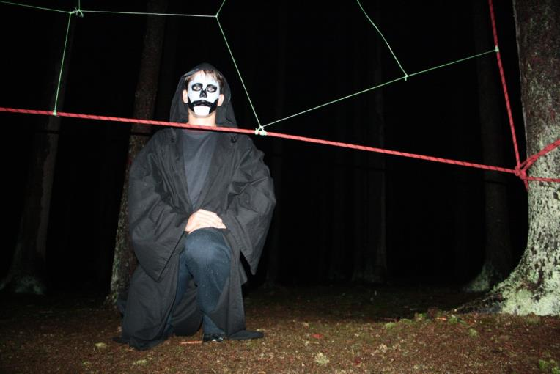
INTRODUCTORY COURSE

Slide 53
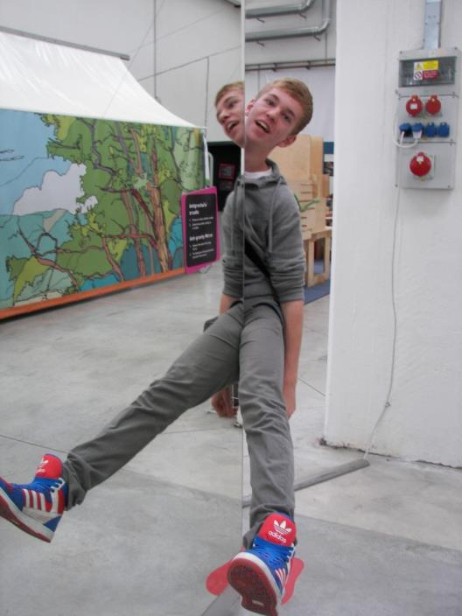
Excursion to Techmania

Slide 54
At this stage we are building constructions just from wooden blocks…

Slide 55
But in future we will design and build …

Slide 56
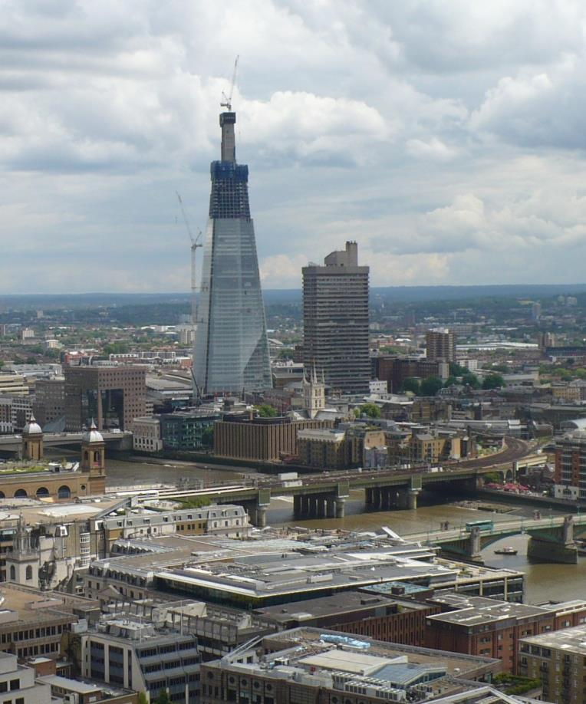
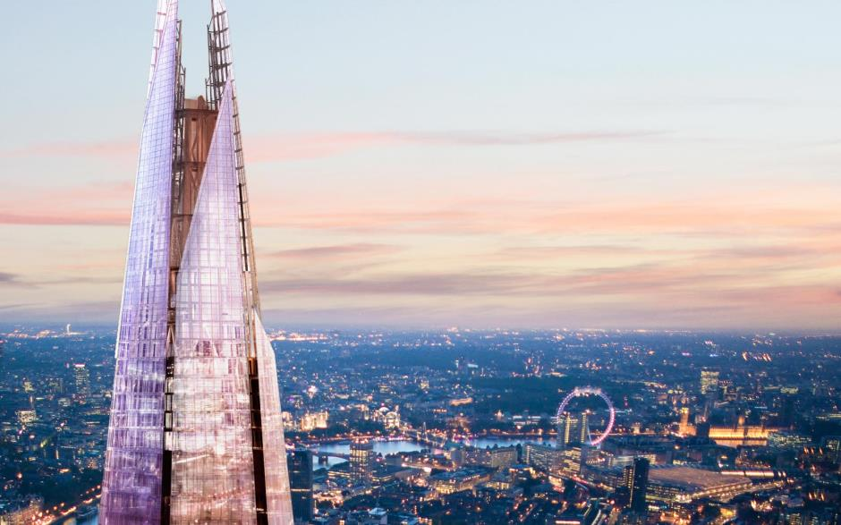
…THIS!!

